Slide 1
Intermediate Training Cycle
The intermediate training cycle is key. It builds the larger training season. Cycles last about one month. This aligns with the body's rhythm. Activity peaks every 23 days. It progresses intensity and volume.
par 1.2.3Licence 1.2.3

Slide 2
Introductory Cycle
Content
Application
Develop endurance and speed-strength. Improve technical skills and flexibility.
Use at season start. Also use after injury return.
Objective
Elevate athlete's level. Move from general to specific.

Slide 3
Basic Cycle
Objective
Content
Application
Enhance general preparation. Improve physiological and technical skills.
Varied training and increased volume. Focus on high-intensity exercises.
Use during various preparation phases.

Slide 4
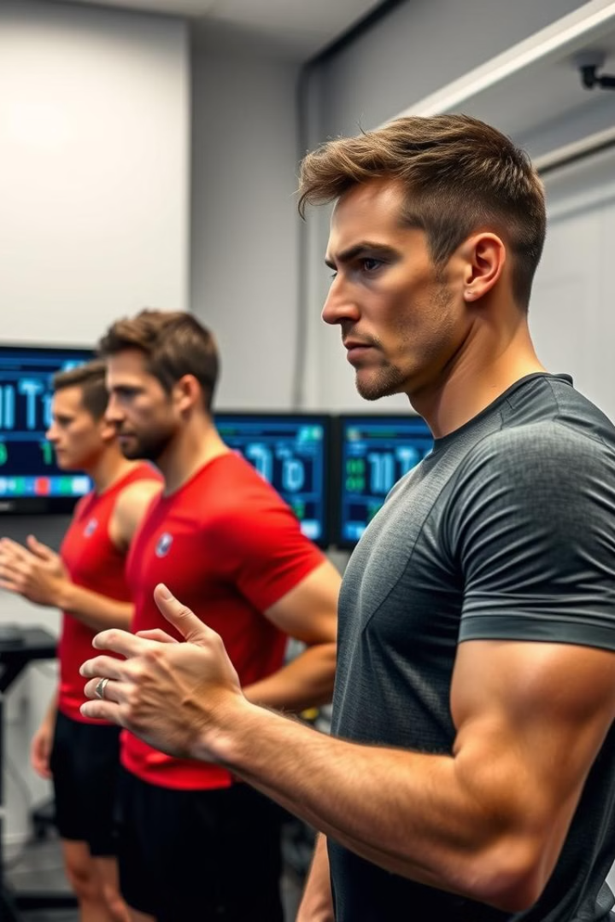
Testing Cycle
Objective
Content
Transition from basic cycles. Prepare for the competition phase.
Intensive training. Focus on competition requirements.
Application
Use before major competitions.

Slide 5
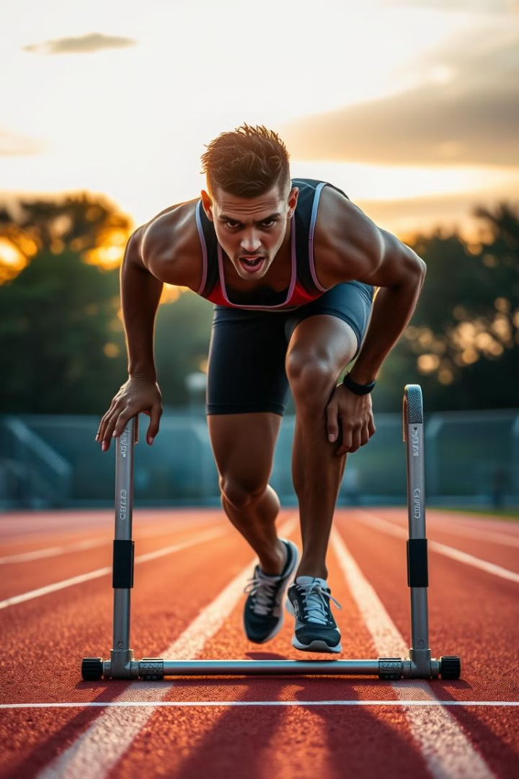
Pre-Competition Cycle
1
Objective
Precise preparation for competition. Address performance deficiencies.
2
Content
Intensive training. Focus on psychological aspects and tactics.
3
Application
Use immediately before major competitions.

Slide 6
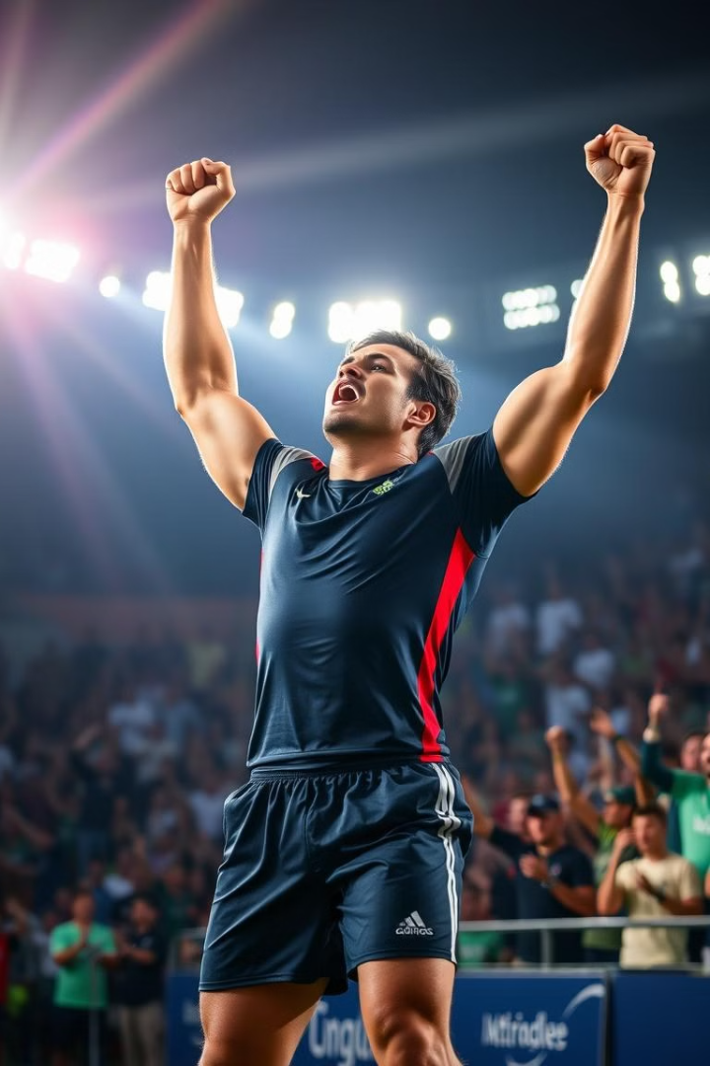
Competition Cycle
Objective
Maintain peak performance and sports form.
Content
Includes preparatory microcycles. Also includes competitive microcycles.
Application
Use during extended competition periods.

Slide 7
Recovery Cycle
Content
2
Light training to maintain peak performance.
Objective
1
Eliminate fatigue and restore energy.
Application
3
Use after competitions or intensive cycles.

Slide 8
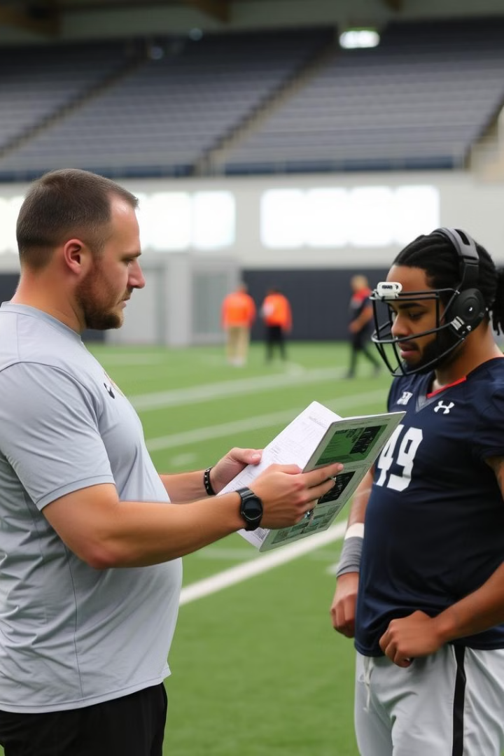
General Notes
1
Individual Differences
2
Scientific Measurements
Coaches consider individual differences. They should also look at training season length.
Rely on scientific measurements. Objective tests are also important.
3
Gradual Progression
Gradual progression is key. Undulation in intensity is also important.

Slide 9
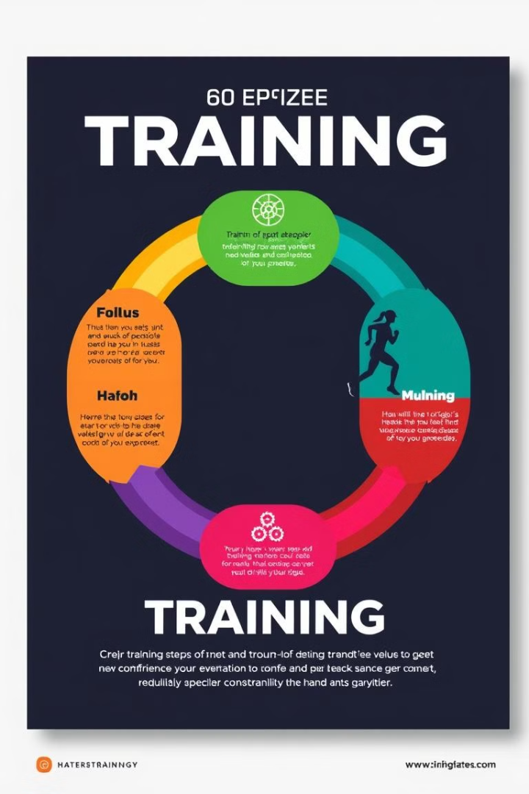
Structural Model for Cycles
Introductory Cycle
Introductory Cycle
Basic Cycle
Recovery Cycle
This structure balances load and recovery. It protects the athlete from fatigue. It optimizes performance for best results.

