Slide 1
Center of Statistical Analysis
How to Use SPSS
CSA-A
Presented By:
EL Hajjar, Said
Associate Professor,
CSA, Director
Second Semester, 2017

Slide 2
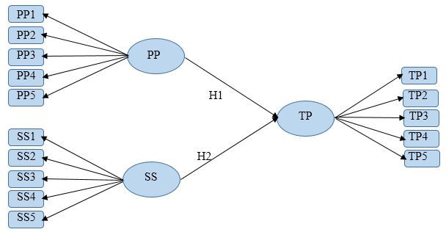
Data Analysis of the following Model.
Activity 1 Analyzing a Model
Statistical Package for the Social Sciences: SPSS Version 23
( Software, Tool, …..)

Slide 3
Data Analysis
Descriptive Statistics
- Summarizing Data
( Bar Graph, Pie Charts,…)
- Measuring Data
(Frequencies, Percentage, Measures of Center and Location, Measures of Variation,…)
- Normality test
(Skewness: score ϵ [ -2, 2 ] and Kurtosis: score ϵ [ -3, 3 ] ) Reference: (Hair et al., 2010)

Slide 4
Data Analysis (Continued)
Reliability and Construct Validity
- Pilot Study
[ Appropriate sample size = 10 % of the project sample size ; (Connelly,2008) ]
- Internal consistency
(Overall Cronbach’s Alpha: score ≥ 0.6 (theory); score ≥ 0.7 (Literature);
Item to item correlation: score > 0.3; Item to total Correlation: score > 0.5;
Cronbach’s alpha if item deleted: score < score of overall Cronbach’s alpha )

Slide 5
Data Analysis (Continued)
Correlation and Linear Regression Analysis
- One - Way ANOVA
(Linear correlation coefficient “ r ” and its significance, Coefficient of determination “ R-
Square “ and its significance, Estimation equation of the regression line and the
significance of its slope )
The data input screen in SPSS consist of two tabs:
“ Variable View” and “Data View”

Slide 6
Variable View
Creating Labels in the ” Variable View ” worksheet
- Name
(The name of the variable, which is used to refer to that variable in syntax. Example:
Gender, Age, height, weight, preferably to input “symbols” of given constructs and
items, it must include all variables used in a proposed model,… It must start with a letter; it
may have up to 8 characters (including letters, numbers, and the underscore. It must not
contain words as "compute", "sum", and so forth. Notice that we can use "cat_dog" but not "cat-dog"
and not "cat dog". The dash gets interpreted as subtraction (cat minus dog) by SPSS, and the space
confuses SPSS as to how many variables are being named. (the unique variable name)
- Type :The two basic types of variables that you will use are numeric and string
*Numeric: A variable whose values are numbers. Ex. Height, Age,…
*String: A variable whose values are not numeric and therefore are not used in
calculations. Uppercase and lowercase letters are considered distinct. Ex.
Names, colors,…
*Comma. A numeric variable whose values are displayed with commas delimiting every
three places and displayed with the period as a decimal delimiter. Ex.
2,345,433.245

Slide 7
Variable View
(Continued)
Creating Labels in the ” Variable View ” worksheet
- Type
*Dot: A numeric variable whose values are displayed with periods delimiting every three
places and with the comma as a decimal delimiter. Ex. 2.345.433,245
*Scientific notation: A numeric variable whose values are displayed with an
embedded E and a signed power-of-10 exponent. Ex. 123,
1.23E2, 1.23D2, 1.23E+2, and 1.23+2
*Date: A numeric variable whose values are displayed in one of several calendar-date or
clock-time formats. Select a format from the list. You can enter dates with
slashes, hyphens, periods, commas, or blank spaces as delimiters. The century
range for two-digit year values is determined by your Options settings (from the
Edit menu, choose Options, and then click the Data tab

Slide 8
Variable View (Continued)
Creating Labels in the ” Variable View ” worksheet
* Dollar: A numeric variable displayed with a leading dollar sign ($), commas delimiting
every three places, and a period as the decimal delimiter. You can enter data
values with or without the leading dollar sign. Ex: $ 234,546.235
*Custom currency: A numeric variable whose values are displayed in one of the
custom currency formats that you have defined on the Currency tab
of the Options dialog box. Defined custom currency characters
cannot be used in data entry but are displayed in the Data Editor.
Ex. BHD, USD, EUR
*Restricted numeric. A variable whose values are restricted to non-negative integers. Values
can be entered in scientific notation.

Slide 9
Variable View
(Continued)
Creating Labels in the ” Variable View ” worksheet
- Width
(The width of a variable is the number of characters SPSS will allow to be entered for the variable. If it is a numerical value with decimals, this total width has to include a spot for each decimal, as well as one for the decimal point. You can change a width by clicking in the width cell for the desired variable and typing a new number or you can use the arrow keys at the edge of the cell . (the number of characters used to display the data).
- Decimals
(It refers to the number of decimals which will be shown. Usually it is labeled by “0” or “2” ). SPSS by default setting indicates two decimal places after the point.
- Label
(The label of a variable is a string of text to identify in more detail what a variable represents. Unlike the name, the label is limited to 255 characters and may contain spaces and punctuation. For instance, if there is a variable for each question on a questionnaire, you would type the question as the variable label). However, use a code for this question, will facilitate the interpretation.

Slide 10
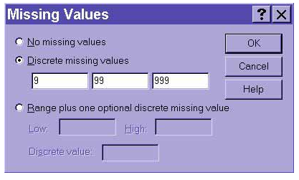
Variable View
(Continued)
Creating Labels in the ” Variable View ” worksheet
- Values
(Need to know which numbers represent which categories. If specific numeric values have a non-intuitive meaning, these values can be labeled (e.g., 1 = male and 2 = female or 1= Strongly Disagree )
- Missing
(Some respondents do not answer all the questions in a survey. Then SPSS will automatically insert a dot in “Data view “ and this will be processed as “system Missing”. Ex. after clicking on the ” ...” button in the Missing cell, I declared "9", "99", and "999" all to be treated by SPSS as missing (i.e., these values will be ignored).Ex. Mike did not answer the question related to his weight, then input “9” for his weight will be used
actually as a code for missing values.

Slide 11
Variable View
(Continued)
Creating Labels in the ” Variable View ” worksheet
- Columns
(The columns property tells SPSS how wide the column should be for each variable. Don't confuse this one with width, which indicates how many digits of the number will be displayed. The column indicates the maximum number of characters which will be shown. Ex. If the number in the column cell is “8” , this means that a number containing 8 digits will be displayed in entirely. A number containing “9” digits will be displayed in an abbreviated scientific notation.
- Align
(The alignment property indicates whether the information in the Data View should be left-justified, right-justified, or centered)

Slide 12
Variable View
(Continued)
Creating Labels in the ” Variable View ” worksheet
- Measure
(The Measure property indicates the level of measurement. Since SPSS does not differentiate between interval and ratio levels of measurement, both of these quantitative variable types are lumped together as "scale". Nominal and ordinal levels of measurement, however, are differentiated)
Nominal - Qualitative variable without order (only categorization possible) example : gender, departments, color, race, nationality etc.
Ordinal - Qualitative variable with order (categorization and order) example Rank, credit rating as High risk, medium risk, Low risk, Likert scale, etc.
Scale - A variable can be treated as scale when its values represent ordered categories with a meaningful metric, so that distance comparisons between values are appropriate. Examples of scale variables include age in years, income in thousands of dollars, temperature in Celsius, weight in Kg etc.
Role
(Input)

Slide 13
Data View
When you view data in SPSS, each row in the Data View represents a case, and each column represents a variable.
Cases represent independent observations, experimental units, or subjects. For example, in likert Scale, cases could be 1, 2, 3, 4 or 5.

Slide 14
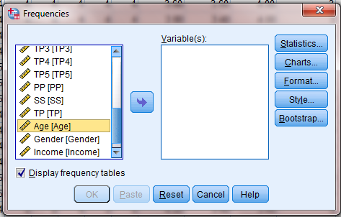
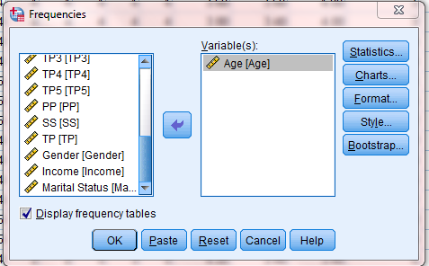
It analyzes the respondent’s personal Information . Data View /Analyze / Descriptive statistics / Frequencies
Description of Data

Slide 15
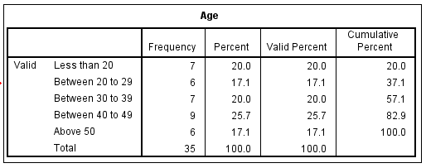
It analyzes the respondent’s personal Information . Output (Age)
Description of Data

Slide 16
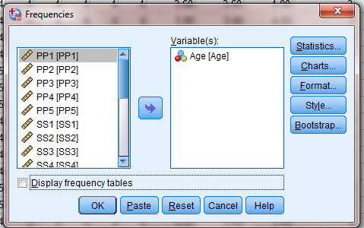
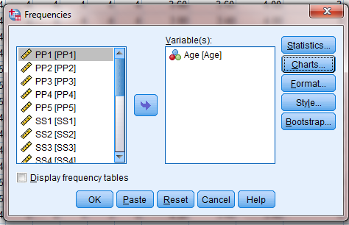
Representation of “Age” through Bar Charts Data View /Analyze / Descriptive statistics / Frequencies/ Options/Bar Charts
Description of Data

Slide 17
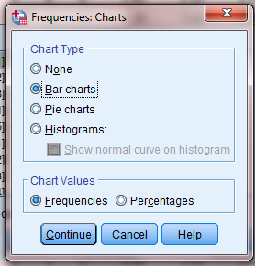
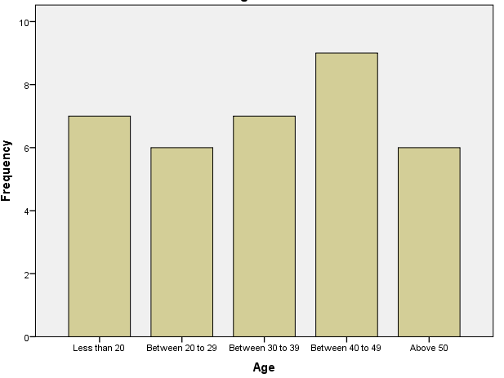
Age: Bar charts
Description of Data

Slide 18
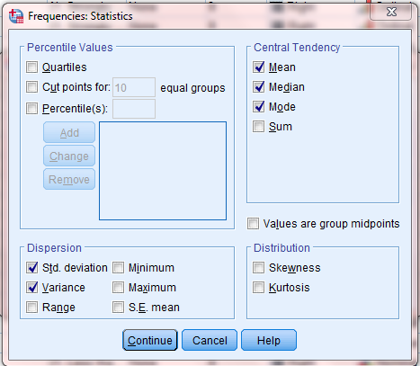
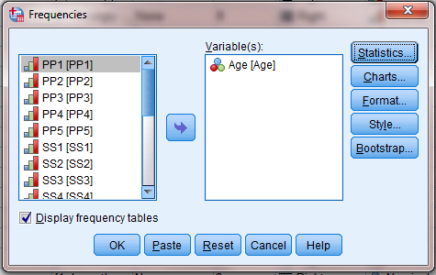
Age: Center of location and variation
Description of Data

Slide 19
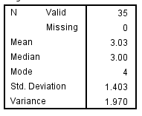
Age: Center of location and variation
Description of Data

Slide 20
Data Analysis of the following Model.
Activity 1 Analyzing a Model

Slide 21
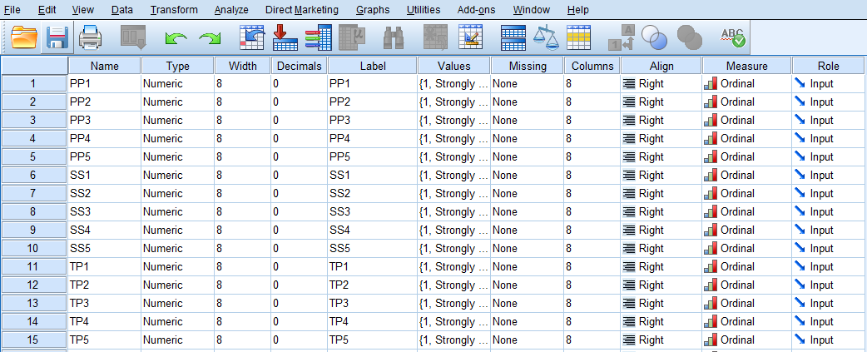
Step 1: Open .SPSS worksheet and fill as follows
Activity 1 (Step by Step )

Slide 22
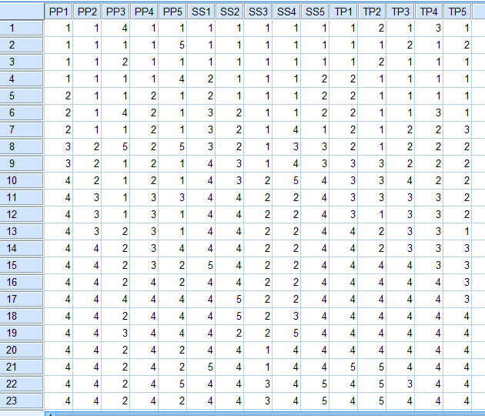
Step 2: Go to Data View and fill as follows
Activity 1 (Step by Step )

Slide 23
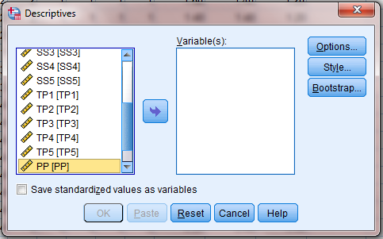
Data View /Analyze / Descriptive statistics / Descriptive/
Step 1: Normality Test

Slide 24
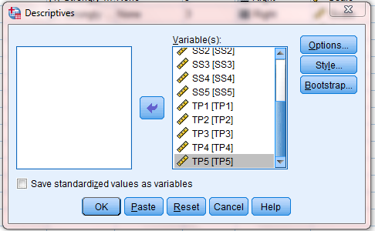
Import the desired variables by clicking the arrow
Step 1: Normality Test

Slide 25
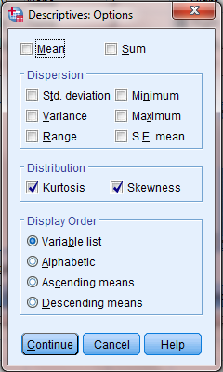
Click on Options and tick as follows, then click on continue and OK:
Step 1: Normality Test

Slide 26
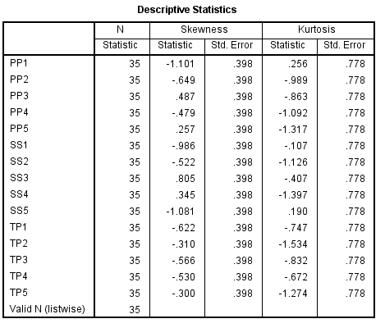
Output:
Step 1: Normality Test

Slide 27
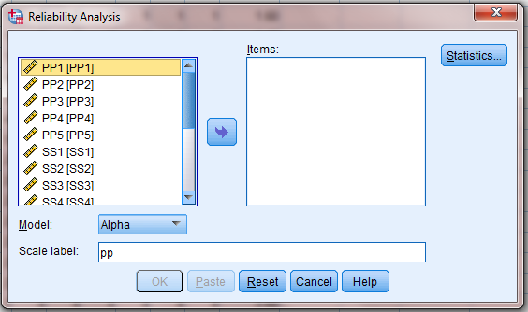
Step 3: Go to “ Analyze” / “ Scale” / “Reliability Analysis” you will get the following windows
Step 2: Reliability and Construct Validity

Slide 28
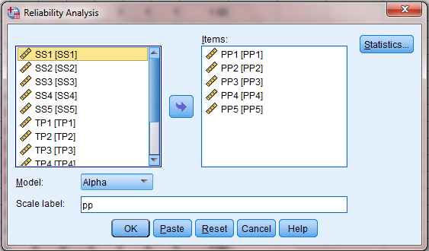
Step 4: Import the desired items to get for example:

Slide 29
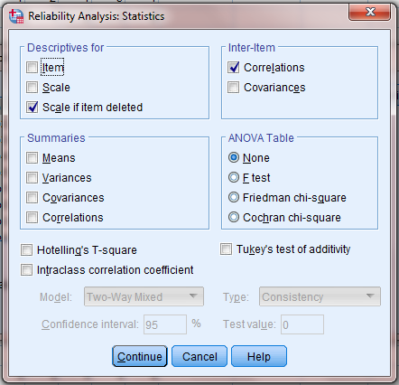
Step 5: Click on “Statistics”, fill in as indicated below a click on “Continue” then “ OK”.

Slide 30
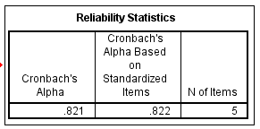
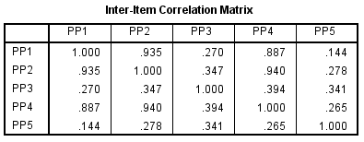
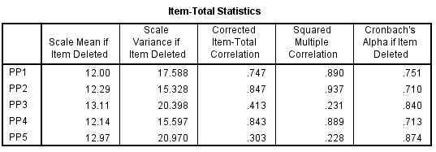
You will get the following outputs:
Note that the interpretation of this result will be done in the Training Course CSA-B

Slide 31
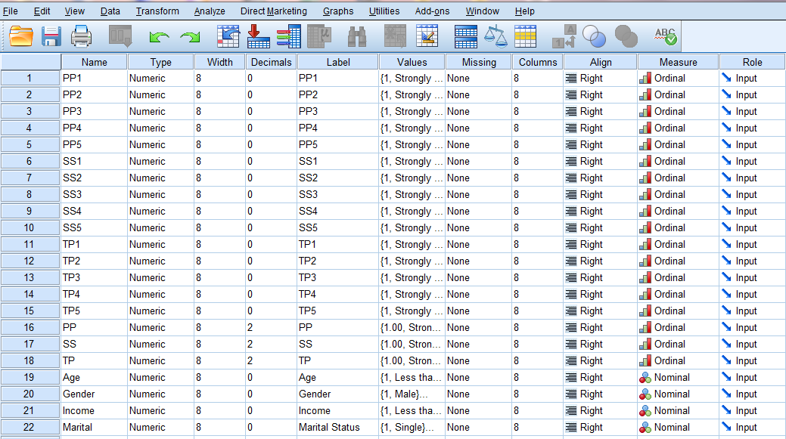
Step 3: Mean of each Construct
Go to variable view worksheet and define the variables
PP, SS, and TP as follows:

Slide 32
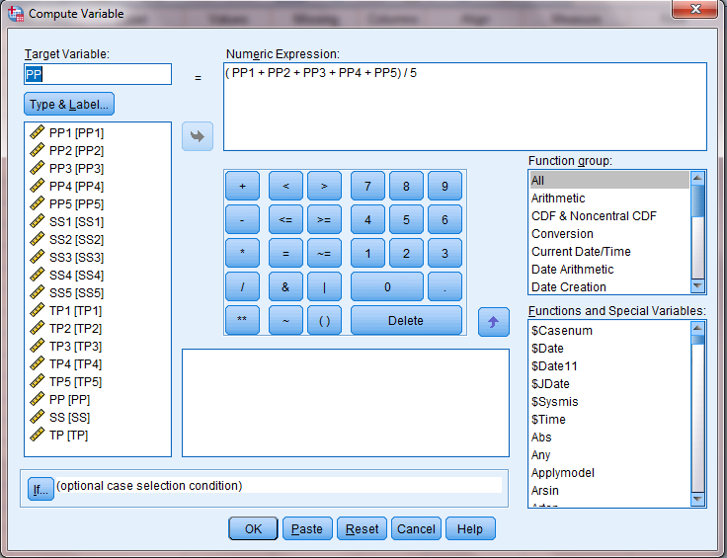
Step 2: Go to “Data View”. Find the mean for PP, SS and TP. Put the curser under PP, then click on Transform / Compute variable/ fill as follows, and click OK. Finally, go to Data View.

Slide 33
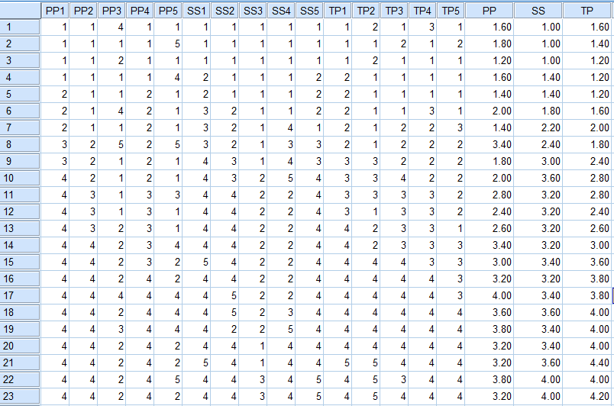
The output will be:

Slide 34
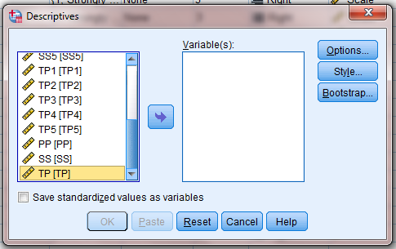
-Descriptive Statistics Data View /Analyze / Descriptive statistics / Descriptives/
Step 4: Descriptive Statistics

Slide 35
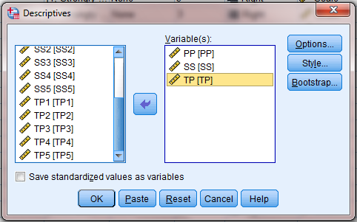
Import the desired variables by clicking the arrow
Step 4: Descriptive Statistics

Slide 36
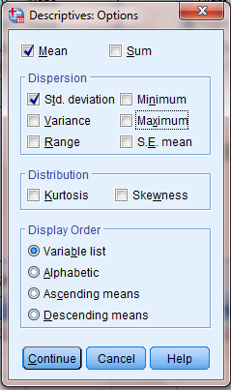
Click on Options and tick as follows, then click on continue:
Step 4: Descriptive Statistics

Slide 37
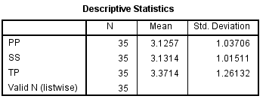
Output:
Step 4: Descriptive Statistics

Slide 38
We need to study the correlation between the independent variables PP and SS with the dependent variable TP. Note that in these test we use the whole collected data set. In SPSS, it is highly recommended to have a sample of size ≥ 240. Linear Correlation Step1: On the SPSS worksheet go to “Variable view” and add PP, SS or TP as follows:
Step5: Correlation

Slide 39
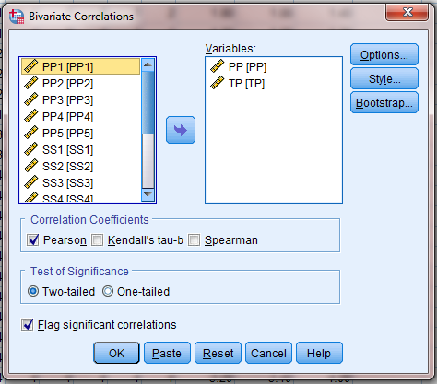
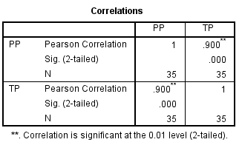
Step 3: Analyze / Correlate / Bivariate Fill as Follows. Redo the same steps for SS with TP
Step5: Correlation
Note that the interpretation will be done in the training course: CSA-C

Slide 40
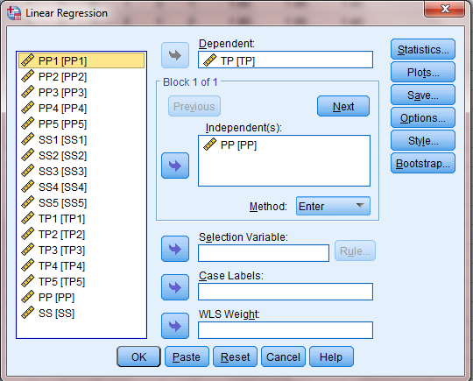
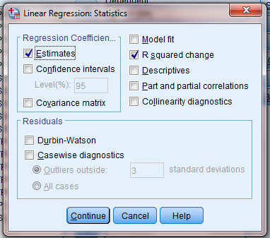
Step 1: Analyze / Regression / Linear
Step6 : Regression Analysis

Slide 41
Step2 : Continue / OK .We get the output:
Step6 : Regression Analysis

Slide 42
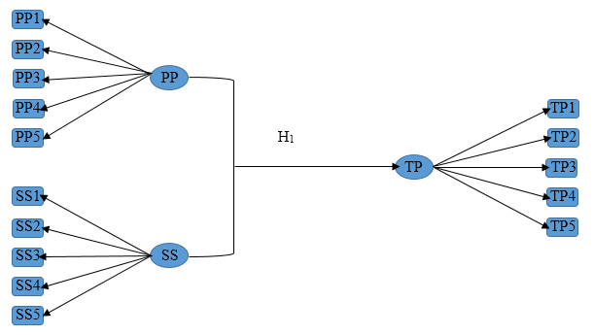
Consider the following Model
Multiple Regression Analysis

Slide 43
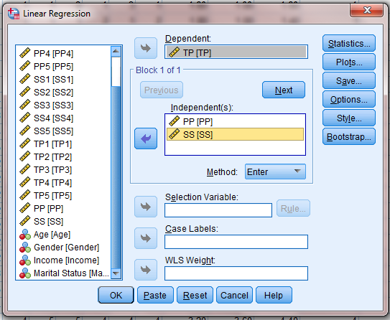
Step 1: Analyze / Regression / Linear
Step6 : Multiple Regression Analysis

Slide 44
Step2 : Continue / OK .We get the output:
Multiple Regression Analysis

Slide 45
End
SPSS is a tool
-If you provide it with flower, it gives you honey
-If you provide it with rubbish, it gives you garbage
Thank you

