Slide 1
Postcolonialism and the Provincializing of Europe
Making of the Modern World May 2016

Slide 2
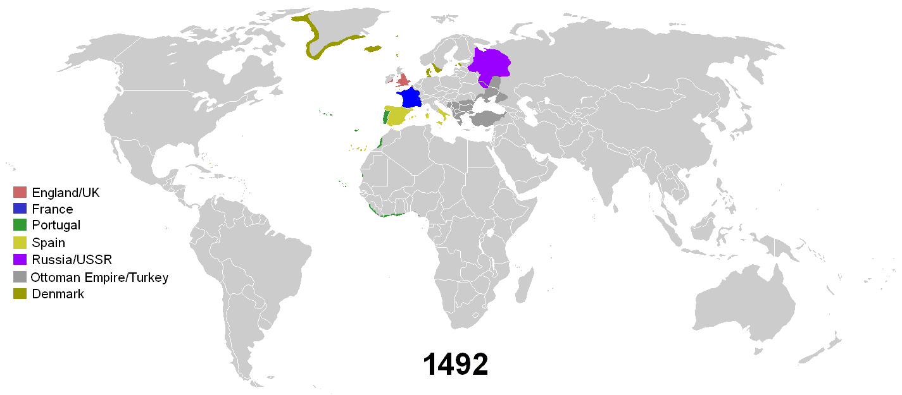

Slide 3
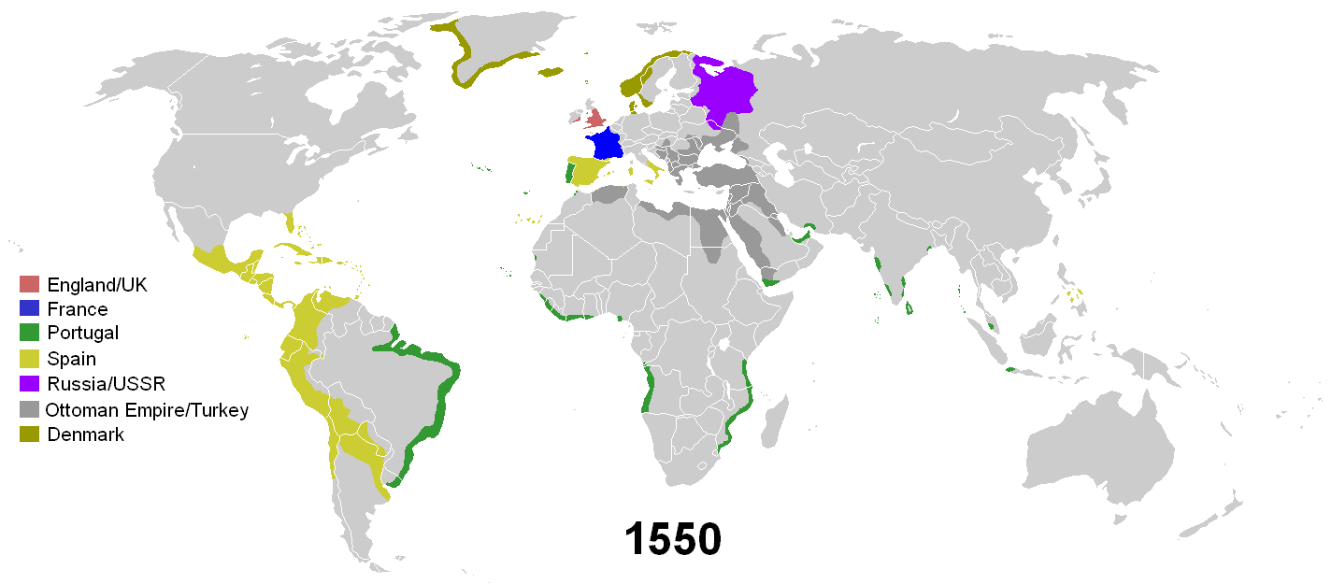

Slide 4
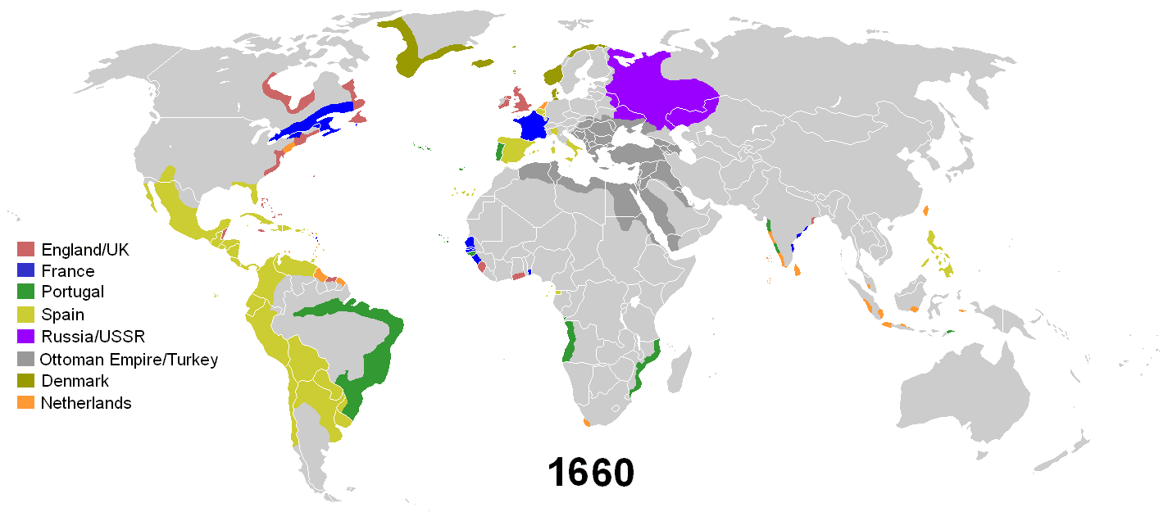

Slide 5
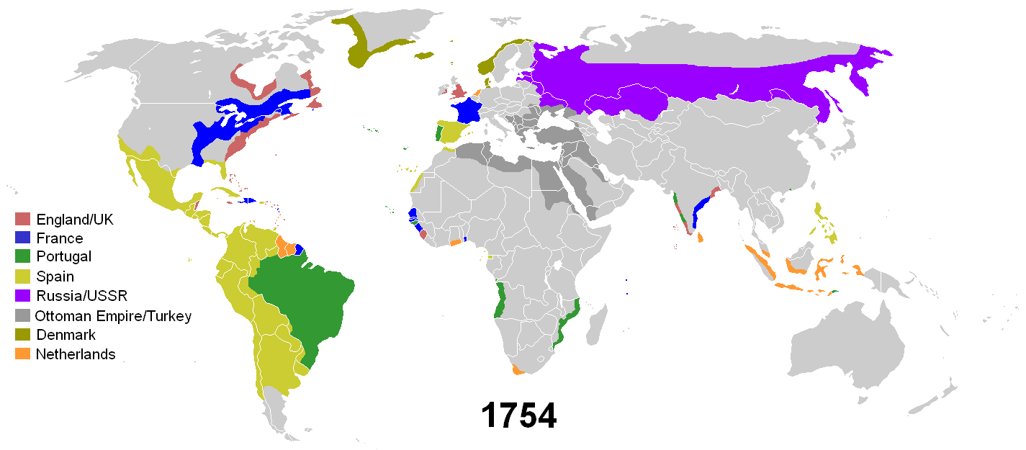

Slide 6
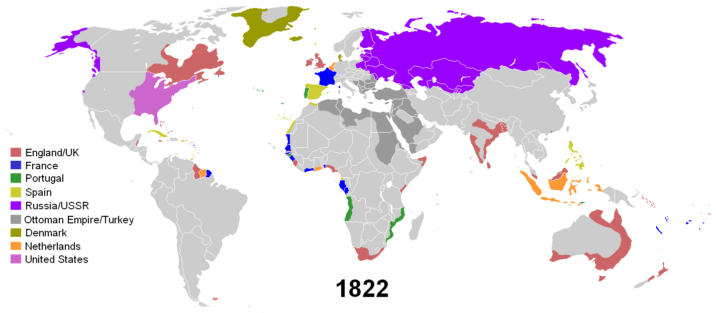

Slide 7
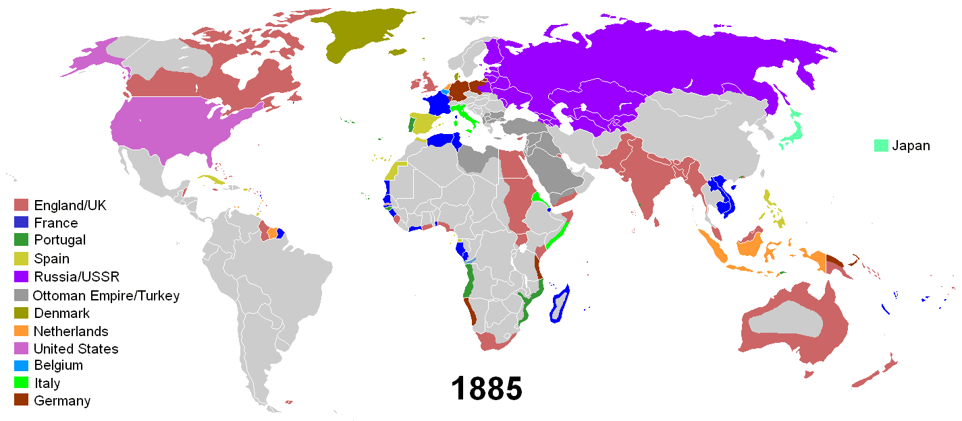

Slide 8
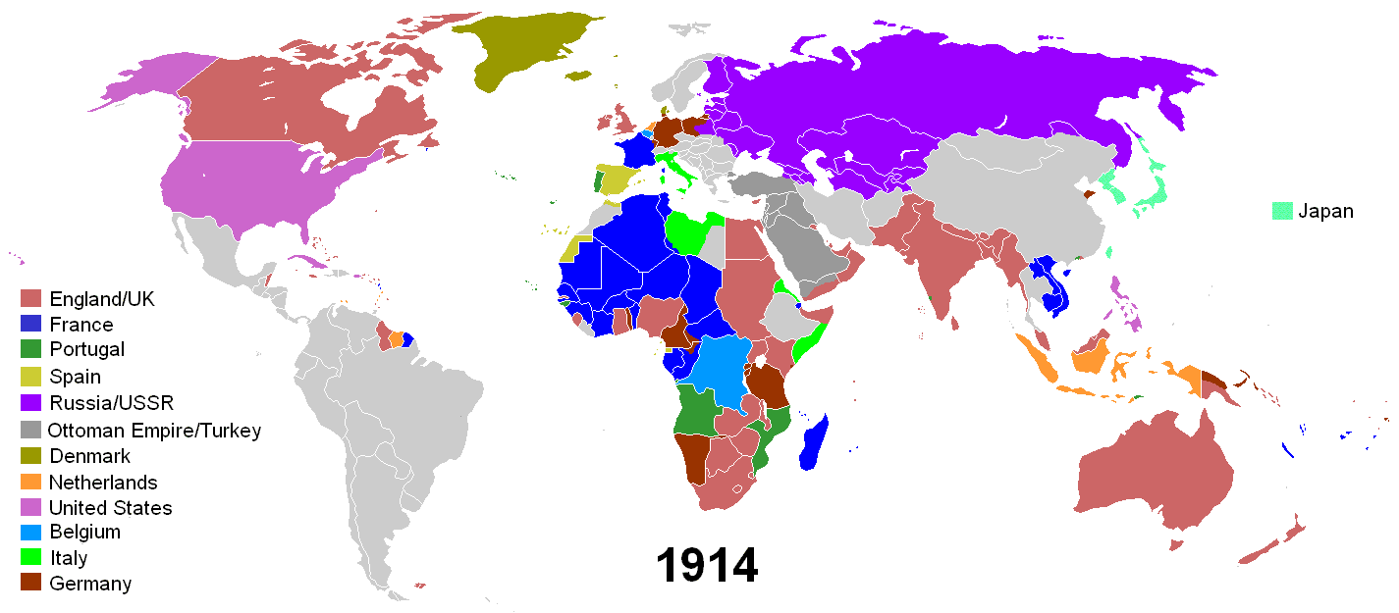

Slide 9
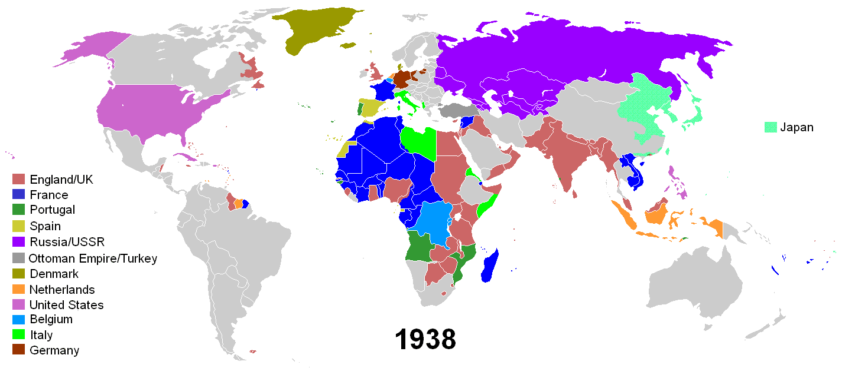

Slide 10
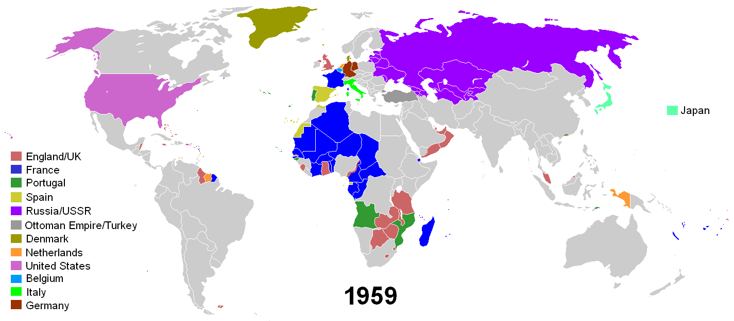

Slide 11
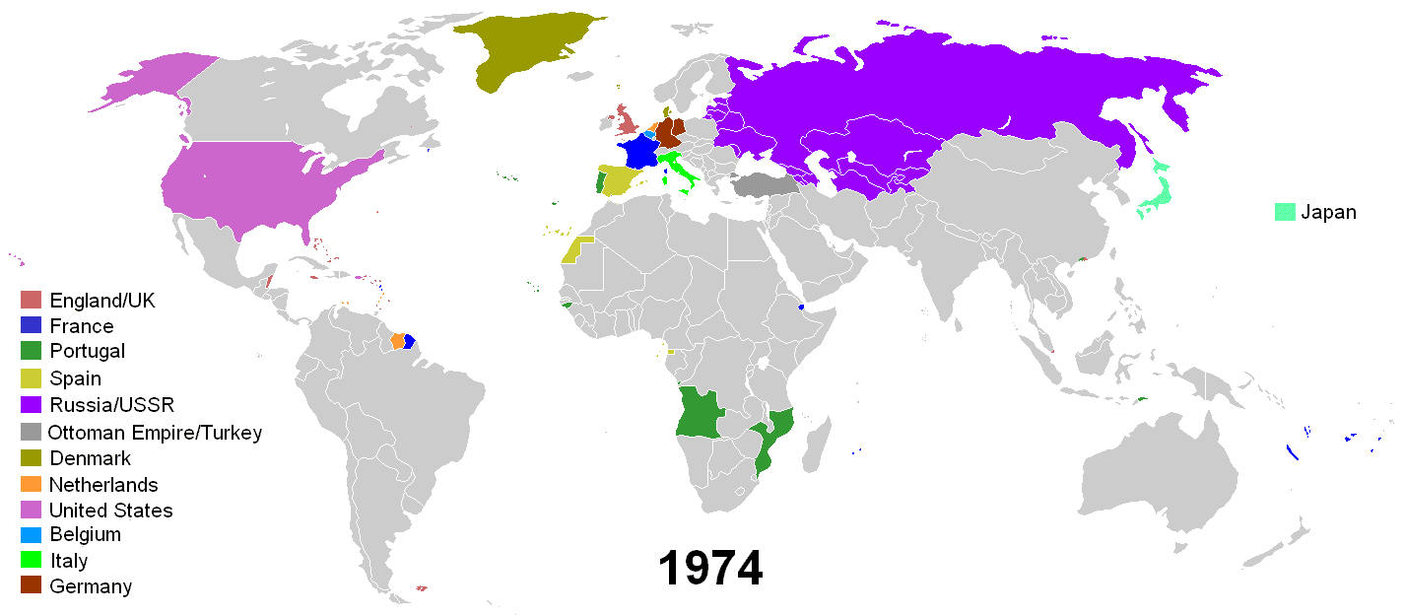

Slide 12
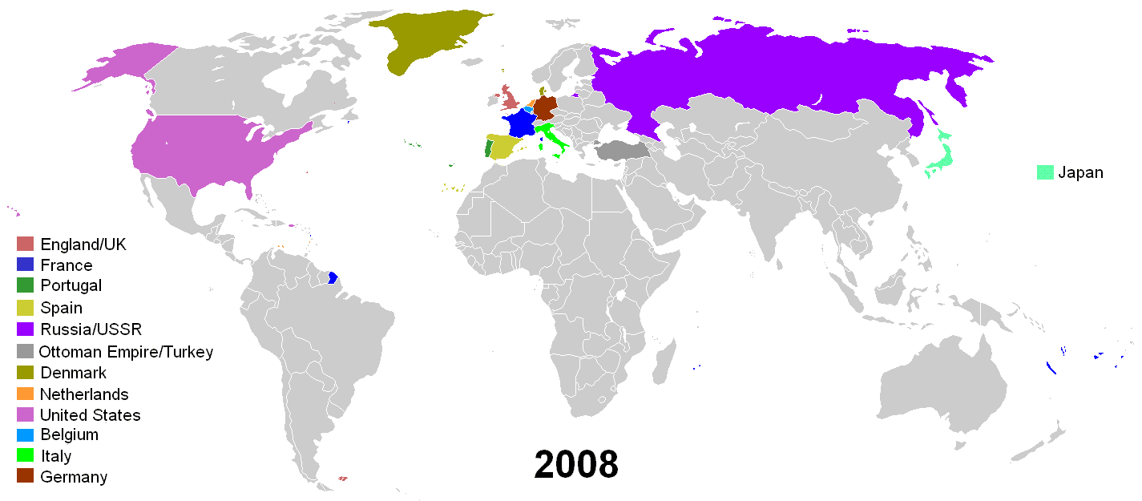

Slide 13
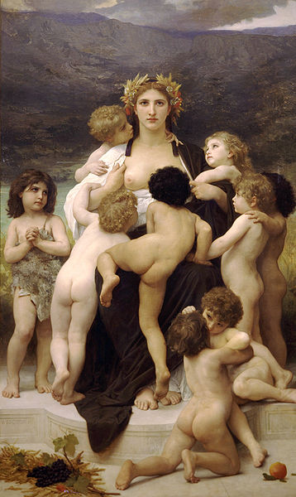
Justifications for Colonialism
Civilising Mission: ideological justification for imperialism. Colonial subjects depicted as childlike, uncivilised, backwards, weak. Perceived material and moral superiority of European/Western civilisation
‘Racism is the psychology of imperialism, the spirit of empire, because racism supplies the element that makes for the righteousness of empire. Hence racism is not simply a by-product of empire but... part of the intestines of empire.’ Jan Nederveen Pieterse, Empire and Emancipation; Power and Liberation on a World Scale (London, 1990), p.223
Cultural logic of imperialism: view of non-Western world as genetically inferior. System of categorisation in which certain races, societies, cultures perceived as inferior
Imperialism as much cultural/ideological as political/economic

Slide 14
Postcolonialism / Postcolonial Studies
Contested concept, no general consensus. Difficult to define ‘postcolonialism’, as is difficult to define ‘colonialism’
Temporal: denotes immediate time after colonialism/independence
Academic discipline: set of intellectual methods that analyse, explain, respond to cultural legacies of colonialism and imperialism
The study of the effects of colonialism on cultures and societies
Postcolonial theory does not presume the end of colonialism, ‘post’ never just means ‘after’
Unlike postmodernism, postcolonialism does not imply direct refuting of preceding paradigm. Instead, acknowledges impacts of colonisation, identifies the experience of imperial domination as important, draws attention to legacies of this history in the present

Slide 15
Postcolonialism / Postcolonial Studies
Critical theory: presents, uncovers, explains the ideology and practice of neo-colonialism
Cross-disciplinary: draws from across the humanities and social sciences, including history; political science; philosophy; sociology; anthropology; human geography; film studies; religious studies; feminism; linguistics; literature; Marxist theory
Literary theory: studies literatures produced by peoples who were once colonial subjects, and literatures of decolonised countries engaged in postcolonial arrangements with former Mother Country
Politics of knowledge: addresses and analyses the politics of knowledge (how ideas are created, used and disseminated) of colonialism and neo-colonialism – how and why imperial regimes represented colonisers and colonised subjects
Postcolonialism usually conceptualised as a political, ethical and literary theory, anti-colonial in character

Slide 16
Critical Purpose
Postcolonialism now well established across humanities and social sciences
Critical purpose is to account for, and combat the residual effects (social, political, cultural) of colonialism upon the peoples once ruled by the Mother Country
Postcolonial theory seeks to establish social and cultural spaces for non-Western peoples (‘subalterns’), whose native cultures were suppressed by the Western value systems promoted as the dominant ideology of colonialism
The critical destabilisation of the theories (intellectual, linguistic, social, economic) that support the ways of Western thought which underpinned colonialism (deductive reasoning, rule of law, monotheism)
Seeks to establish intellectual spaces for subalterns to ‘speak’ for themselves, in their own voices

Slide 17
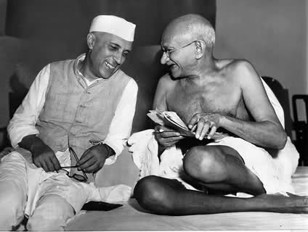
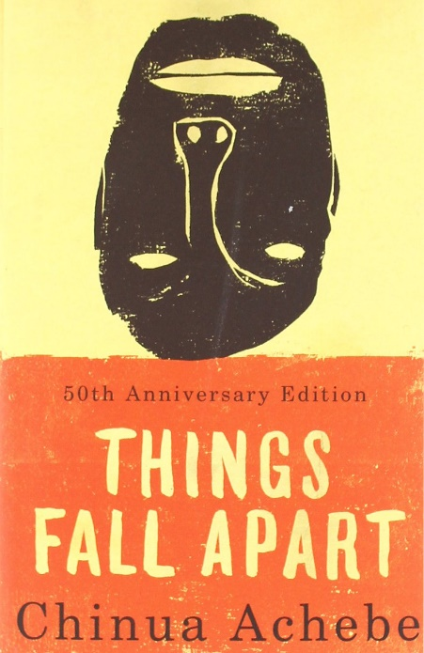
Political and Literary Origins
Political roots can be traced back to wave of radical anti-colonial literature in later decades of Empire
Mohandas K. Gandhi, Hind Swaraj (1909) W. E. B. Du Bois, Color and Democracy: Colonies and Peace (1945) Frantz Fanon, Black Skin, White Masks (1952) Aimé Césaire, Discourse on Colonialism (1955) Albert Memmi, The Colonizer and the Colonized (1957)
Chinua Achebe, Things Fall Apart (1958): essential novel on African identity, nationalism, decolonisation. Highlights fight between colonialism and traditional African society in 1890s Nigeria.
Jean Rhys, Wide Sargasso Sea (1966): postcolonial re-telling of Charlotte Bronte's Jane Eyre (1847). Familiar story re-told as a prequel, from perspective of subaltern protagonist Antoinette Cosway. Exemplar postcolonial novel

Slide 18
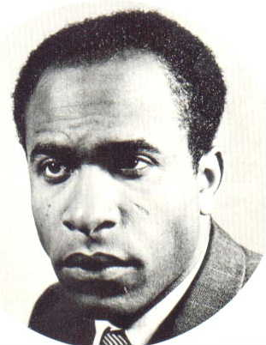
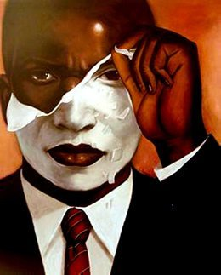
Frantz Fanon (1925-61)
Martinique-born Afro-Caribbean psychiatrist, philosopher, revolutionary, writer
Concerned with psychopathology of colonisation, and consequences (human, social, cultural) of decolonisation
Black Skin, White Masks (1952): applies psychoanalysis to explain feelings of dependency and inadequacy that Black people experience when colonised – lose native culture, embrace and try to imitate culture of Mother Country (white masks)
The Wretched of the Earth (1961): psychiatric and psychologic analysis of the dehumanising effects of colonisation. Advocates violence as necessary for successful decolonisation
Fanon deeply important to postcolonial studies, a major figure in theorising anti-colonial resistance. Entire body of work is a call to cast off colonialism and its legacies, and bring about a more just world

Slide 19
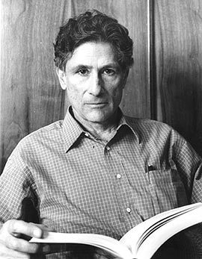
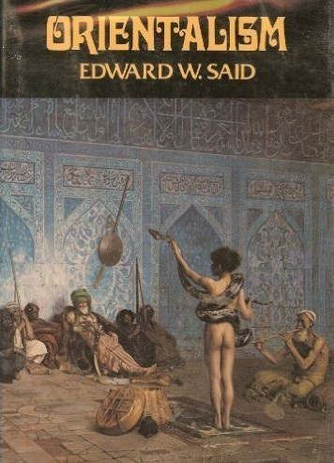
Edward Said (1935-2003)
Palestinian literary theorist, Professor of English, History and Comparative Literature, public intellectual, founding figure of postcolonialism
Orientalism: term used by scholars, describes depiction of Eastern (‘Oriental’) cultures by Western artists and writers.
In 18th and 19th centuries, an ‘Orientalist’ was a scholar who specialised in the languages and literatures of the East
Term ‘Orientalism’ redefined and transformed in 1978, when Said published his influential and controversial book, Orientalism

Slide 20
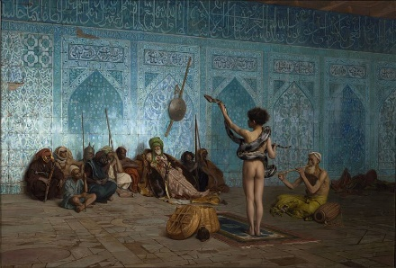
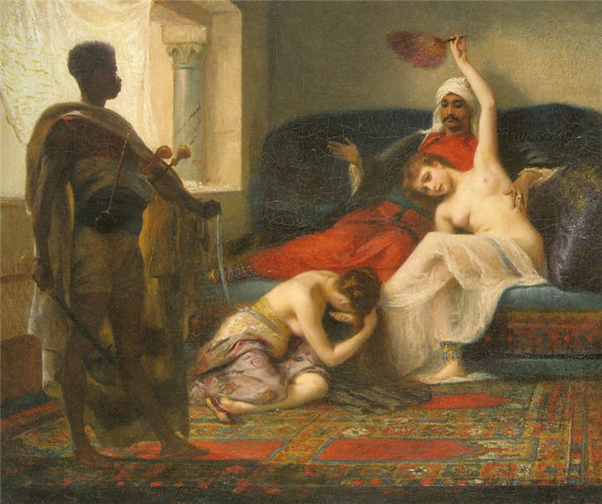
Edward Said, Orientalism (1978)
Western representations of the East/Orient closely tied to imperial power – depict Oriental culture as irrational, weak, feminised, ‘Other’. Contrasted with rational, strong, masculine culture of the West
Orientalism a pervasive Western tradition (academic and artistic), produce prejudiced interpretations of the East, shaped by attitudes of European imperialism in 18th and 19th centuries
Orientalism continues to resonate today, e.g. demonization of Islam in news and popular culture
Orientalism had profound impact. Established Said as an ‘intellectual superstar’, became foundational text of Postcolonialism. Helped establish a ‘central truth’ – that demeaning images of the Orient closely connected with imperial expansion
Popularised the notion of a colonial discourse (discourse: formal way of thinking expressed through language, defines what can be said about a topic)

Slide 21
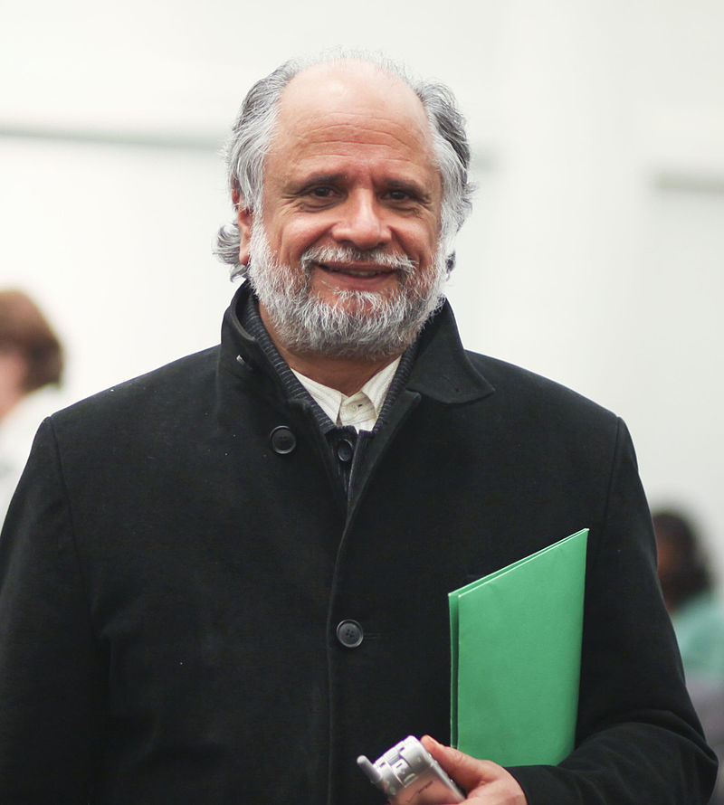
Homi K. Bhabha (1949-)
Professor of English and American literature and language, popularised postcolonial theory by developing new terms and concepts
Ambivalence: coloniser/colonised relationship is complex, characterised by attraction and repulsion. Colonial discourse wants to produce compliant subjects, instead produces ambivalent subjects whose mimicry is never far from mockery
Hybridity: contact between coloniser/colonised cultures is complex, messy, contradictory – produces new ‘hybrid’ cultural forms. Makes claims to hierarchical ‘purity’ untenable
Mimicry: colonial discourse encourages subjects to ‘mimic’ the coloniser, but result is never a simple reproduction – can appear to parody what it mimics. Reveals limitations and cracks in colonial authority

Slide 22
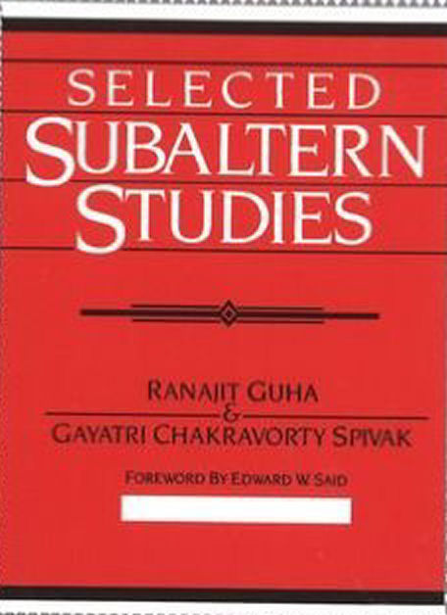
Subaltern Studies
Subaltern Studies Group (SSG) of South Asian scholars interested in postcolonial societies, with focus on South Asia
Rose to prominence in 1980s, inspired by their mentor Ranajit Guha – historian of South Asia (especially peasantry), set agenda for SSG, edited early works
SSG on the political left, but very critical of traditional Marxist histories of India – focus on political consciousness of elites, who in turn inspired the masses to resistance and rebellion
SSG instead focuses on subalterns (non-elites) as agents of political and social change. History from below, focus on base levels of society

Slide 23
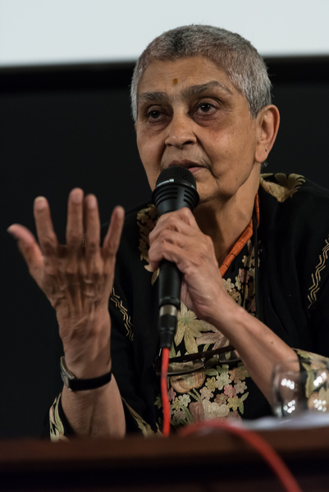
Gayatri Chakravorty Spivak (1942-)
Indian scholar, literary theorist, feminist critic. One of most influential postcolonial intellectuals. Best known for her essay ‘Can the Subaltern Speak?: Speculations on Widow Sacrifice’ (1985)
Postcolonialism attempts to liberate the oppressed subaltern, to articulate its own experiences. Can the subaltern ever truly speak? Spivak suggests (controversially) that the answer is no.
Spivak criticises tendency to romanticize subalterns. Subalterns never a homogenous group, do not share the same cultural identity, solidarity, aims and purposes
Subaltern has no privilege, enters official discourse rarely and usually through mediating commentary. Tough to imagine how the subaltern can ever genuinely speak
To be heard and known, the subaltern must adopt Western ways of knowing, of thought, reasoning, and language. Must conform their non-Western knowledge of colonial life to Western ways of knowing the world. Can the third world subject ever be studied without cooperation in the colonial project?

Slide 24
Dipesh Chakrabarty (1948-)
Professor in History, made important contributions to postcolonial theory and subaltern studies with his book Provincializing Europe: Postcolonial Thought and Historical Difference (2000)
Argues that the discipline of history, as developed at the time of Enlightenment, was rooted in the idea of human progress, from cave man to European global hegemony (historicism)
Powerful legacy of the Enlightenment in universalised concepts, which have influenced projects of modernity all over the world: citizenship, human rights, public sphere, civil society, democracy, popular sovereignty, the state, equality before the law, social justice
We cannot think of political modernity without these concepts, yet they are never truly universal. Carry the legacy of the Enlightenment

Slide 25
Provincializing Europe
Chakrabarty not calling to reject or discard European thought, which is both ‘indispensable and inadequate’ to understand modernity in non-Western nations. But how do we retain these notions, while making room for alternative ways of life and practice?
‘Provincializing’ Europe: - move beyond Eurocentrism; - combat European Orientalism; - question universalism; - dismantle the intellectual, political, and economic legacies of European imperialism; - analyse how postcolonial literatures ‘write back’ to former centres of imperial power in Europe; - destabilise the myth that the European experience is the ‘normal’ path of development for all other histories
These challenges and objectives are central to the academic and political concerns of postcolonial studies

Slide 26
Postcolonialism and Postmodernism
Complex relationship, both heavily impacted on literary study, have many differences but are also comparable
Both are transdisciplinary; celebrate marginal groups; dissolve languages of power; fascinated with subversive strategies of mimicry, parody, irony; work to deconstruct ‘meta-narratives’ (totalizing comprehensive theories, based on appeals to universal truth/values)
Postmodernism deconstructs centralised, meta-narratives of European culture. Similarities with the aim of postcolonialism to dismantle the foundations of colonial discourse
In purest form, postmodernism rejects all great collective social identities such as class, race, nation, gender. This includes Marxism, and any form of emancipatory theory
Postcolonialism is overtly emancipatory, is driven by concerns with liberation and justice. Arguably strives for a new postcolonial ‘meta-narrative’ of modernity itself

Slide 27
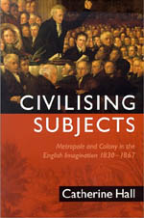
Postcolonial and Historians
Postcolonial theory reinvigorated historical studies of colonialism and imperialism. Move beyond Eurocentrism, make use of insights of postcolonial theorists to produce nuanced and cross-disciplinary studies of nation-making and empire
Challenge the concepts and processes that remove the indigenous subject and subaltern from history
Take active role in challenging unequal power relations. Interrogate and rewrite the historical narratives embedded by imperial powers
Move beyond Eurocentrism, make use of insights of postcolonial theorists to produce nuanced and cross-disciplinary studies of nation-making and empire
Catherine Hall, Civilising Subjects (2002): argues that the idea of empire was at the heart of mid-19th century British self-imagining, with peoples such as the ‘Aborigines’ in Australia and the ‘negroes’ in Jamaica serving as markers of difference separating ‘civilised’ English from ‘savage’ others

Slide 28
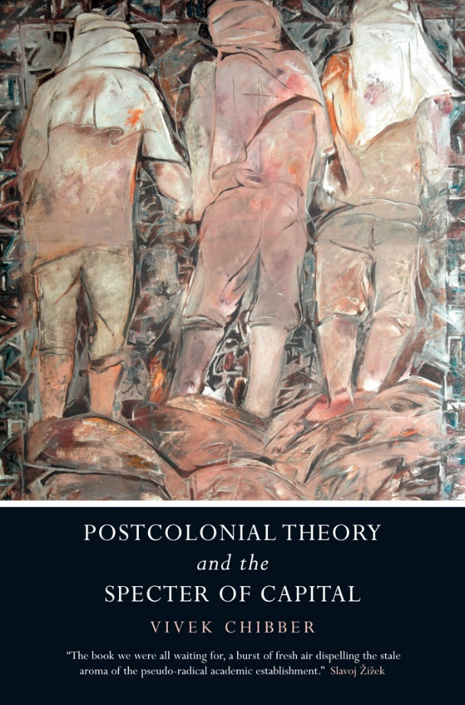
Critiques and Challenges
Too academic – lacks the radical energy and urgency of the anti-colonial movements it claims to follow. De-radicalises what these movements stood for, reworks them into forms consistent with current academic fashions
Emphasises aesthetic issues over concrete material issues involving economic and cultural exploitation
Lacks clear political direction, focuses on formerly colonised nations and obscures ongoing neo-imperialism/colonialism in the present
Vivek Chibber: by undermining universal values, postcolonialism denies that people across the world have universal aspirations and interests. Therefore, presents the differences between East and West as unbridgeable, actually endorses Orientalism rather than challenging it
Spirit of postcolonialism is ongoing self-critique – value of term ‘postcolonial’ continually interrogated and questioned

