Slide 1
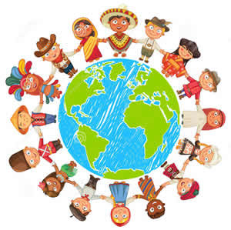
Norms and Values

Slide 2
What are norms?
What are values?

Slide 3
Values
Values refer to intangible qualities accepted and endorsed by a given society. They are considered of great worth. Values are distinct from attitudes, traits, norms, and symbols.

Slide 4
Values
• Values are broad ideas about what is good or appropriate shared by people in a society.
• Values have tremendous influence on human social behavior, they can be involved in most aspects of life.

Slide 5
• Values tend to be unobservable.
• Values tend to have historical and cultural variability.
• Values express a yearned-for state of being.

Slide 6
Examples of modern U.S. values include :
Success, freedom, liberty, autonomy, democracy, progress, comfort, education, competition, wealth, and tolerance.

Slide 7
Norms
Norms refer to conditions for social relations between groups and individuals, for the structure of society and the difference between societies, and for human behavior in general.

Slide 8
Norms are guiding principles that direct society and define how people should behave with other members.
Norms lead interactions by dictating anticipated doings in different situations.
How are norms applied?: Sanctions, rewards or punishments used to encourage people to follow norms. (Informal: embarrassment, avoidance, stigma, physical and verbal reactions; Formal: authority, governments, laws, courts, and trials)

Slide 9
Types of norms
• Folkways refer to norms that protect common conventions. Most people in a society follow traditional folkways but failure to conform to them is considered neither illegal nor immoral.
• Mores refer to stronger norms with associated moral values. Examples of common mores found in the United States include prohibitions against murder, or desecration of religious symbols.
• Taboos: Taboos include the belief that certain activities are outside the bounds of cultural acceptance. Violations of mores and taboos tend to be treated with strong social disapproval or criminal consequences.
Laws are formally enforced by political authority and backed by the power of the state. Laws may enforce norms or work to change them.

