Slide 1
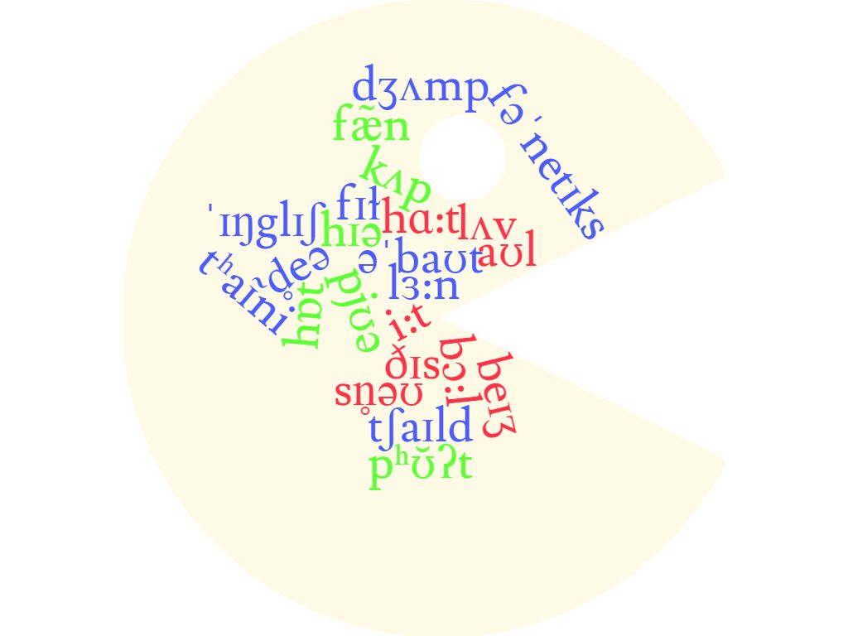
1st year Phonetics Course
Lectures by Sohila MEKHOUKH
Updated April 2021
smekhoukh@yahoo.fr

Slide 2
Phonetics Quiz
Multiple choice questions in class in the last session.
Work hard!
Good luck!

Slide 3
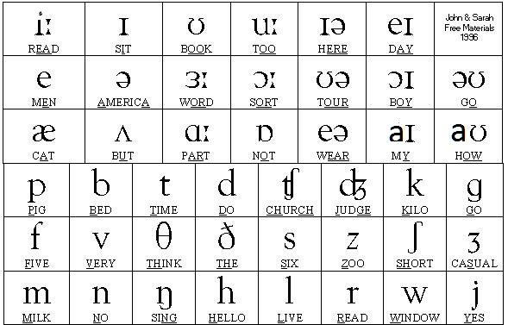
Consonants Vs. Vowels
Difference between consonants and vowels
Level of stricture (obstruents Vs. sonorants)

Slide 4
Consonants Vs. Vowels
Level of stricture (obstruents Vs. sonorants)
Obstruents
Plosives, Fricatives, Affricates
Sonorants
Vowels, Nasals, Approximants

Slide 5
Consonants Vs. Vowels
Difference between consonants and vowels
Vowels | Consonants
Always produced with vibration | Produced with or without vibration
Air escapes through the mouth only | Air escapes through the mouth or nose
The air stream is not blocked in any way in the throat or mouth by the tongue and/or lips (-consonantal) | The air stream from the lungs is completely or partially blocked by the tongue or lips (+consonantal)

Slide 6
Consonants Vs.vowels exercise
B The definite article is pronounced ðə before a consonant phoneme and ði before a vowel phoneme. Select the appropriate form from the drop-down menus for each word in the list.
1 way ði / ðə
2 opening ði / ðə
3 house ði / ðə
4 oyster ði / ðə
5 use ði / ðə
6 whale ði / ðə

Slide 7
Consonants & vowels exercise (Answer key)
B The definite article is pronounced ðə before a consonant phoneme and ði before a vowel phoneme. Select the appropriate form from the drop-down menus for each word in the list.
1 way ði / ðə
2 opening ði / ðə
3 house ði / ðə
4 oyster ði / ðə
5 use ði / ðə
6 whale ði / ðə

Slide 8
Phonetics Course
Lectures by Sohila MEKHOUKH
Updated April 2021
smekhoukh@yahoo.fr

Slide 9
Plosives (oral stops)
Plosives: | bilabial | alveolar | velar | glottal
voiceless | /p/ pop, paper | /t/ tea, worked, kettle | /k/ cook, ache, quay | /ʔ/ what, that, but, bottle, a
voiced | /b/ Bob, bad, robbed | /d/ deed, muddle | /g/ go, league, exam
Aspiration
Devoicing
Glottalization
Phonotactics
Exercise

Slide 10
Plosives (oral stops)
Aspiration ( we talk about the phonological description)
A small "explosion" of air when you make a sound.
Fortis plosives /p t k/ are pronounced as aspirated in initial position and at the beginning of a stressed syllable. E.g., cart [kʰɑ:t], potato [pəˈtʰeɪtəʊ], depend [dɪˈpʰend], attack [əˈtʰæk]
But they lose their aspiration after /s/. E.g., speak [spi:k], steal [sti:l], scout [skaʊt], (in initial position)
Diacritic: [pʰ, tʰ, kʰ]
/p, t, k/ lose their aspiration in final position. E.g: weep [wi:p], eat [i:t], fake [feɪk].

Slide 11
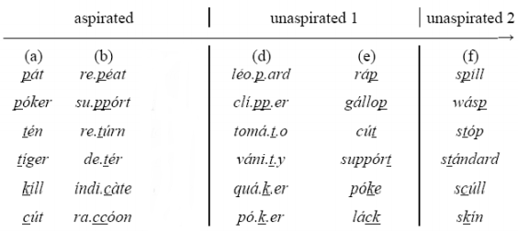
Plosives (oral stops)
Aspiration

Slide 12
Plosives (oral stops)
Devoicing
Phonetically speaking, /b d g/ are normally voiced, but they become devoiced when they occur in initial and final positions, E.g., bad [b̥æd̥], bag [b̥æg̥].
Diacritic: devoicing [b̥] [d̥] [g̥]
Lenis consonants are fully voiced intervocally(between two voiced sounds), fortis consonants are always voiceless, e.g., nobody [ˈnəʊbədi] both [b] and [d] are fully voiced.

Slide 13
Plosives (oral stops)
Glottalization
Diacritic: [ʔ]
Glottalization occurs just before /p t k/ or /t∫/ at the end of a monosyllabic word or at the end of a stressed syllable
/p t k/ must be preceded by a vowel and followed by a pause or a consonant.
The most widespread glottalisation is that of /t/ where the glottal stop replaces the /t/, e.g., ‘what’, ‘that’, ‘but’, ‘bottle’.
With t∫: nature [ˈneɪʔt∫ә] (end of a stressed syllable
catching [ˈkæʔt∫ɪŋ] (end of a stressed syllable
riches [ˈrɪʔt∫ɪz] (end of a stressed syllable
With p t k: Rick [rɪʔk] (end of a monosyllabic word
petral [ˈpeʔtrәl] (end of a stressed syllable
mat [mæʔt] (end of a monosyllabic word
cup [kʌʔp] (end of a monosyllabic word

Slide 14
Phonotactics (consonant clusters)
In initial position, P,t, k can be followed by a consonant (one of the set of / l /, / r /, / w / and / j /) or a vowel. Play / p l eɪ / Crowd / k r aʊ d / Twins / t w ɪ n z /, Cube / k j uː b / Pay / p eɪ / Tea / t iː /
They can be preceded by the consonant “s” like Splendid / ˈsplendɪd / Scream / skriːm / Stream /striːm /
/ p / and / k / are silent before / n /.
/ p / is also silent before the consonant “s” and “t”, and it’s pronounced / f / when occurring before the letter “h”. Pneumonia/ njuːˈməʊnɪə / Knit / nɪt / psychology / saɪˈkɒlədʒi / pterodactyl / ˌterəˈdæktɪl / philosophy / fɪˈlɒsəfi /.
in final position they can be combined with /s/ and /t/.

Slide 15
(b,d, g )can never be preceded by a consonant.
They can be followed by a consonant (one of the set of / l /, / r /, / w / and / j /) or a vowel. Blue / bluː / Dwell / dwel/ Grind / ɡraɪnd / Beauty /bju:ti/ Bye / baɪ / Dye / daɪ / Guy / ɡaɪ /
In initial position / g / becomes silent before / n /. Gnome / nəʊm / gnaw / nɔː /
In final position, / b / is silent after / m /. Comb / kəʊm / Limb / lɪm / and / g / becomes silent before final / m /. Diaphragm / ˈdaɪəfræm / phlegm / flem /.

Slide 16
Plosives exercise
Choose from the list of consonants below the appropriate symbol for the plosive described.
1 voiceless alveolar plosive /p/ /t/ /k/ /b/ /d/ /g/ /ʔ/
2 voiced velar plosive /p/ /t/ /k/ /b/ /d/ /g/ /ʔ/
3 voiced bilabial plosive /p/ /t/ /k/ /b/ /d/ /g/ /ʔ/
4 voiceless velar plosive /p/ /t/ /k/ /b/ /d/ /g/ /ʔ/
5 glottal plosive /p/ /t/ /k/ /b/ /d/ /g/ /ʔ/
6 voiceless bilabial plosive /p/ /t/ /k/ /b/ /d/ /g/ /ʔ/
7 voiced alveolar plosive /p/ /t/ /k/ /b/ /d/ /g/ /ʔ/

Slide 17
Plosives exercise (Answer key)
Choose from the list of consonants below the appropriate symbol for the plosive described.
1 voiceless alveolar plosive /p/ /t/ /k/ /b/ /d/ /g/ /ʔ/
2 voiced velar plosive /p/ /t/ /k/ /b/ /d/ /g/ /ʔ/
3 voiced bilabial plosive /p/ /t/ /k/ /b/ /d/ /g/ /ʔ/
4 voiceless velar plosive /p/ /t/ /k/ /b/ /d/ /g/ /ʔ/
5 glottal plosive /p/ /t/ /k/ /b/ /d/ /g/ /ʔ/
6 voiceless bilabial plosive /p/ /t/ /k/ /b/ /d/ /g/ /ʔ/
7 voiced alveolar plosive /p/ /t/ /k/ /b/ /d/ /g/ /ʔ/

Slide 18
Practice
Define the consonant sounds in the middle of each of the following words
Voicing Aspiration place of articulation manner of articulation
adder
hopper
Hispanic
middle
particular
robber
absent

Slide 19
Phonetics Course
Lectures by Sohila MEKHOUKH
Updated April 2021
smekhoukh@yahoo.fr

Slide 20
Fricatives & Affricates
Fricatives: | alveolar | palato-alveolar | dental | labio-dental | glottal
voiceless | /s/ see, scent, muscle, pence, cent | /ʃ/ shy, sugar, machine, initial, special | /θ/ thin breath | /f/ leaf, fish phone, laugh | /h/ hello, who
voiced | /z/ zeal, xylophone, busy, dogs | /ʒ/ genre, beige, measure | /ð/ this breathe | /v/ vet, leave
Devoicing
Intensity of friction (slit & groove)
Phonotactics
Exercise
Afficates: | palato-alveolar
voiceless | /tʃ/ church, question, itch
Voiced | /dʒ/ judge, gem, soldier, sandwich

Slide 21
Fricatives & Affricates
Devoicing
/v ð z ʒ dʒ/ are normally voiced, but they become devoiced in casual speech when they occur in initial and final positions, E.g., judge[dʒ̥ʌdʒ̥], views [v̥ju:z̥].
Diacritic: [v̥ ð̥ z̥ ʒ̥ dʒ̥]
Lenis consonants are fully voiced intervocally, e.g., amazing [əˈmeɪzɪŋ]

Slide 22
Fricatives & Affricates
Intensity of friction (slit & groove)
Slit:
f v θ ð
Groove (sibilants):
s z ʃ ʒ (tʃ dʒ)

Slide 23
Fricatives & Affricates
Phonotactics
/h/ is never final.
The fricative /f/ can be preceded initially by /s/. E.g., sphere /sf/. /s/ can be followed by the voiceless plosives and some of the approximants initially. E.g., spy /spaɪ/, sky /skaɪ/, stay /steɪ/, sweet /swi:t/, suit /sju:t/, slay /sleɪ/.
Some fricatives are combined with one of the approximants initially. E.g., huge /hju:dʒ/, throw /θrəʊ/, view /vju:/, shrink /ʃrɪŋk/.
The affricates cannot be in a consonant cluster both initially, but they can be preceded by /n/ finally. E.g., lunch /lʌntʃ /, plunge /plʌndʒ/.
/ʒ/ is rarely initial or final.
z ð ʒ cannot be in a cluster initially.
Silent letters: ha(lf)penny, i(s)land, ai(s)le, shep(h)erd, (h)our, (h)eir, ve(h)icle, fore(h)ead, r(h)yme, ex(h)ibit, Birming(h)am, san(d)wich.

Slide 24
Fricatives & Affricates exercise
Each word in the following list is composed of fricatives, affricates and vowels (including diphthongs). Write the orthographic (spelling) form of the word in the box, then check your answer.

Slide 25
Fricatives & Affricates exercise (answer key)
Each word in the following list is composed of fricatives, affricates and vowels (including diphthongs). Write the orthographic (spelling) form of the word in the box, then check your answer.
1 hedge hedʒ
2 these ðiːz
3 sheath ʃiːθ
4 sage seɪdʒ
5 chiefs tʃiːfs
6 faces feɪsɪz
7 achieve ətʃiːv
8 feather feðə
9 shave ʃeɪv
10 judge dʒʌdʒ

Slide 26
Practice
Identify the consonant sounds in the middle of each of the following words
and then characterize the sound.
Word | Sound | Voicing | Place of articulation | Manner of articulation | Intensity of friction
father etching ether pleasure lodger | ………… ………… …… | ………………………. ……………… | ………………… ………………… ………………… ………………… ………………… | …………………………………………. …………………………………………. ……………………. | …………………….. …………………………………………. ………………………………………….

Slide 27
Phonetics Course
Lectures by Sohila MEKHOUKH
Updated April 2021
smekhoukh@yahoo.fr

Slide 28
Nasals (nasal stops)
Devoicing
–ng pronunciation
Nasalization
Phonotactics
Exercise
Nasals: | bilabial | alveolar | velar
voiced | /m/ madam, mute, come | /n/ nun, no, many | /ŋ/ think, thing /θɪŋk/, /θɪŋ/

Slide 29
Nasals (nasal stops)
Devoicing
Nasals are usually voiced. /m/ and /n/ can only be preceded by /s/ initially and in this case these two nasals become devoiced. Example: smile [sm̥aɪl], snail [s̥neɪl]

Slide 30
Nasals (nasal stops)
Pronunciation of final –ng
The morpheme is the smallest unit of semantic meaning. E.g., sing+er, finger, un+want+ed
At the end of a morpheme, /g/ disappears after n. E.g., thing /θɪŋ/, bang /bæŋ/, wrong /rɒŋ/, singer /sɪŋə/, wrongly /rɒŋli/.
When ‘ng’ occurs in the middle of one-morpheme words, /g/ doesn’t disappear, e.g., finger /fɪŋgə/, single /sɪŋgl/, language /læŋgwɪdʒ/, bangalow /ˈbæŋɡələʊ/.
Exceptions:
long /lɒŋ/, longer /lɒŋgə/, longest /lɒŋgɪst/,
strong /strɒŋ/, stronger /strɒŋgə/, strongest /strɒŋgɪst/,
Young /jʌŋ/, younger /jʌŋgə/, youngest /jʌŋgɪst/.

Slide 31
Nasals (nasal stops)
Nasalization
Vowels in English are noticeably nasalized when they occur before nasal consonants in the same syllable. E.g., ‘ban’ /bæn/ [bæ̃n]
See the difference between:
a name [ə neɪ̃m] Vs an aim [ə̃n eɪ̃m]
Diacritic: [ẽɪ] [ʌ̃] [i:̃]

Slide 32
Nasals (nasal stops)
Phonotactics
Only short vowels occur before /ŋ/. E.g., song /sɒŋ/, hung /hʌŋ/, peng /peŋ/, kingdom /kɪŋdəm/, fang /fæŋ/.
The velar nasal /ŋ/ is never initial.
Nasals are usually voiced. /m/ and /n/ can only be preceded by /s/ initially and in this case they become devoiced.
/m/ and /n/ can be followed by the glide /j/. Example: mute /mju:t/, new /nju:/.
Clustering of nasals in final position: bump flint blink fence find think finger
Silent /m/ initially: (m)nemonic. Silent /n/ finally: colum(n).

Slide 33
Nasals exercise
The velar nasal ŋ occurs in all the words in the following list. In some of them the ŋ is followed by g in BBC pronunciation, while in others there is no g. Choose ‘with g’ or ‘without g’ as appropriate.
1 angle with g / without g
2 singer with g / without g
3 strongest with g / without g
4 linger with g / without g
5 willingness with g / without g
6 springy with g / without g

Slide 34
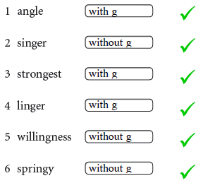
Nasals exercise (Answer key)
The velar nasal ŋ occurs in all the words in the following list. In some of them the ŋ is followed by g in BBC pronunciation, while in others there is no g. Choose ‘with g’ or ‘without g’ as appropriate.

Slide 35
Phonetics Course
Lectures by Sohila MEKHOUKH
Updated April 2021
smekhoukh@yahoo.fr

Slide 36
Approximants (Liquids & Glides)
Liquids & glides
Devoicing
Devoicing
Rhoticity
Velarization
Phonotactics
Exercise
Approximants: | alveolar | palato-alveolar | labio-velar | palatal
voiced | /l/ little, ill, lullaby | /r/ write, brow, ring, scary | /w/ what, wet, water, language, quite | /j/ you, euro, unit, ewe, nephew, few

Slide 37
Approximants (Liquids & Glides)
Liquids & glides
Liquids:
l r
Glides:
w j

Slide 38
Approximants (Liquids & Glides)
Devoicing
/j r w l/ are voiced in initial positions and become devoiced after the voiceless obstruents (plosives and fricatives).
E.g.: tune [tj̥u:n], praise [pr̥eɪz], quick [kw̥ɪk], plot [pl̥ɒt], few [fj̥u:], slow [sl̥əʊ].

Slide 39
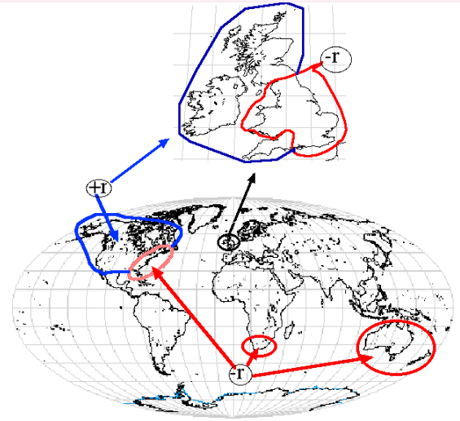
Approximants (Liquids & Glides)
Rhoticity
A rhotic accent is one in which the letter 'r' is pronounced wherever it appears in the spelling. E.g., crowd /kraʊd/, right /raɪt/, sparrow /spɑ:rəʊ/, far away /fɑ:rəweɪ/, daring /deərɪŋ/, dare /deər/, learn /lɜ:rn/, four /fɔ:r/.
In non-rhotic accents 'r' is only pronounced immediately before a vowel sound – which can be in the same word or in the following word. E.g., crowd /kraʊd/, right /raɪt/, sparrow /spɑ:rəʊ/, far away /fɑ:rəweɪ/, daring /deərɪŋ/, dare /deə/, learn /lɜ:n/, four /fɔ:/. RP (Received Pronunciation) is non-rhotic. ('iron' /aɪən/ is an exception.)

Slide 40
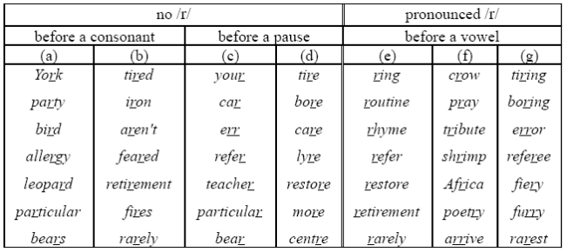
Pronunciation of r

Slide 41
Approximants (Liquids & Glides)
Velarization
Diacritic: [ɫ]
Clear /l/ as in ‘lip’. This is the pronunciation of /l/ when it is followed by a vowel or the consonant /j/. E.g.: lamp [læmp], love [lʌv], look [lʊk], follow [fɒləʊ], miller [mɪlə], value [vælju:].
Dark /l/ as in ‘milk’. This is the sound of /l/ when it is not followed by a vowel. E.g.: help [heɫp], wealthy [weɫθi], fall [fɔ:ɫ], mill [mɪɫ], battle [bætɫ̩].

Slide 42
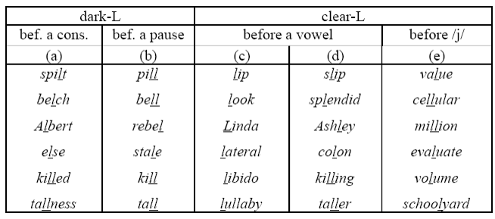
Approximants (Liquids & Glides)
Velarization

Slide 43
Approximants (Liquids & Glides)
Phonotactics
/w/ and /j/ are always initial, never final. E.g., Ya(ch)t /jɒt/, yes /jes/, huge /hju:dʒ/, white /waɪt/, quick /kwɪk/, one /wʌn/, twice /twaɪs/.
Silent letter w: t(w)o, (w)hom, (w)hole, (w)rite, Chris(w)ick, (w)ho, (w)hose, s(w)ord, (w)rong, ans(w)er.
Silent letter r: i(r)on, i(r)oning, i(r)onmonger, ca(r), the(r)e, ha(r)m.
Silent letter l: ha(l)f, ca(lf), ha(lf)penny, ca(l)m, pa(l)m, a(l)mond, ta(l)k, cha(l)k, wa(l)k, cou(l)d, shou(l)d, wou(l)d, fo(l)k, yo(l)k, Suffo(l)k, sa(l)mon, co(l)onel /ˈkɜ:nəl/.
/r/ cannot be final in RP.

Slide 44
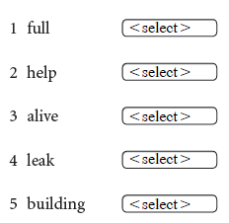
Approximants exercise
“Clear l” and “dark l” have their own appropriate contexts of occurrence in BBC pronunciation. In the words below, choose “clear” or “dark” for the correct allophone of l.

Slide 45
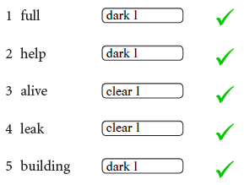
Approximants exercise (Answer key)
“Clear l” and “dark l” have their own appropriate contexts of occurrence in BBC pronunciation. In the words below, choose “clear” or “dark” for the correct allophone of l.

Slide 46
Phonetics Course
Lectures by Sohila MEKHOUKH
Updated April 2021
smekhoukh@yahoo.fr

Slide 47
Force of articulation
Fortis Vs. Lenis consonants
Pre-fortis clipping
Exercise
 | Fortis | Lenis
Bilabial plosives Alveolar plosives | p t | b d
Velar plosives | k | g
Alveolar fricatives | s | z
Labio-dental fricatives | f | v
Dental fricatives | θ | ð
Palato-alveolar fricatives | ʃ | ʒ
Palato-alveolar affricates | tʃ | dʒ

Slide 48
Force of articulation
Fortis Vs. Lenis consonants
If a consonant is voiceless the air stream is strong and it is called fortis.
If a consonant is voiced the air stream is weak and it is called lenis.
 | plosives | fricatives | affricates | nasals | approximants
fortis (voiceless) | p t k | f s ʃ θ | tʃ
Lenis (voiced) | b d g | v z ʒ ð | dʒ | m n ŋ | l r w j

Slide 49
Force of articulation
Pre-fortis clipping
Vowels followed by fortis consonants are shortened. E.g., right [raɪ̆t] Vs ride [raɪd], mute [mjuˑt] Vs mule [mju:l].
Diacritic: [ӗ] [uˑ] [ěɪ]
might fate right lock feet house book loose cut bought coat beat | fight fade ride log feed how bull lose come board code bead | mate rip bat bark loaf goat boss leaf voice late bit bet | made rib bad barn loan gold bomb leaves boys laid bid bed

Slide 50
Force of articulation exercise
Transcribe the words phonetically and indicate with the proper diacritic, which of them contain a shortened vowel as a result of a following fortis consonant.
Tea | Toast | Oak | Speed
Meat | Stalk | Kite | Partake
Toad | Play | Fish | Book
Dark | Lunch | Breath | Goat
Card | Pierce | Breathe | Car
Lip | Beard | Lobe | Bad
Egg | Birth | full | Food

Slide 51
Force of articulation exercise (answer key)
Tea [tʰi:] | Toast [tʰəʊ̌st] | Oak [əʊ̌ʔk] | Speed [spi:d̥]
Meat [miˑʔt] | Stalk [stɔˑʔk] | Kite [kʰaɪ̌ʔt] | Partake [pɑ:ˈtʰeɪ̌ʔk]
Toad [tʰəʊd̥] | Play [pʰl̥eɪ] | Fish [fɪ̌ʃ] | Book [b̥ʊ̌ʔk]
Dark [d̥ɑˑʔk] | Lunch [lʌ̃ntʃ] | Breath [b̥rěθ] | Goat [g̥əʊ̌ʔt]
Card [kʰɑ:d̥] | Pierce [pʰɪə̌s] | Breathe [b̥ri:ð̥] | Car [kʰɑ:]
Lip [lɪ̌ʔp] | Beard [b̥ɪəd̥] | Lobe [ləʊb̥] | Bad [b̥æd̥]
Egg [eg̥] | Birth [b̥ɜˑθ] | full [fʊɫ] | Food [fu:d̥]

Slide 52
Phonetics Course
Lectures by Sohila MEKHOUKH
Updated April 2021
smekhoukh@yahoo.fr

Slide 53
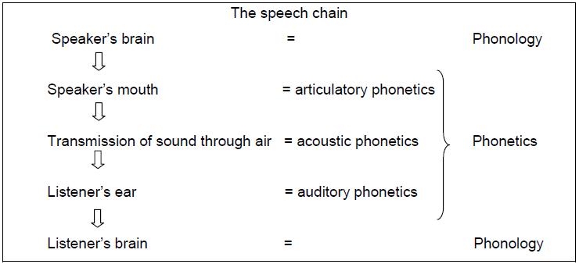
Phonetics Vs Phonology
Difference between phonetics and phonology
Phoneme Vs. Allophone
Phonetic transcription Vs phonemic transcription
Exercise

Slide 54
Phonetics Vs Phonology
Difference between phonetics and phonology
Phonetics is the study and description of the nature of the raw noises and silences of speech.
Phonology is the study and description of the patterning of the noises and silences of speech in regular ways within particular languages.
One cannot study the linguistic function of sounds in language (phonology) with no reference to their articulatory or acoustic features (phonetics) and vice versa.
Phonetics | Phonology
Narrow Physical | Broad Mental
Neutral A 'natural' science | Related to a particular language A 'linguistic' science

Slide 55
Phonetics Vs Phonology
Phoneme Vs. Allophone
A phoneme is an abstract unit of speech sound that can distinguish words. That is, changing one phoneme in a word can produce another word (see minimal pairs).
An allophone is one of several similar speech sounds that belong to the same phoneme. An allophone is not distinctive, but rather a variant of a phoneme, won’t change meaning but the result may sound awkward.
 | Writing | Speech
Abstract (mental) level | The alphabet (26 letters) | The phonemic system (44 phonemes)
Concrete (physical) level | An infinite number of shapes & sizes on paper | An infinite number of realizations (allophones)

Slide 56
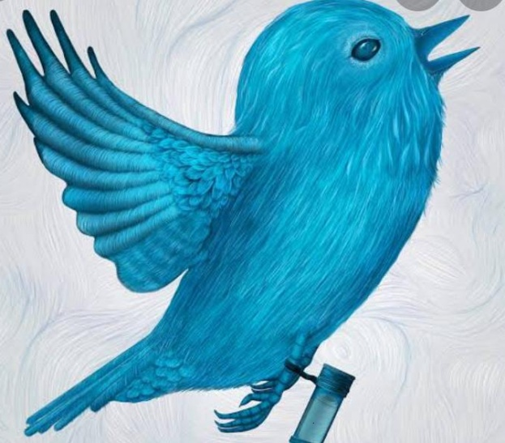
Phonetics Vs Phonology
Phonetic transcription Vs phonemic transcription
[ ̌ ʰ ̃ ̥ ɫ ʔ] / /
narrow (detailed) broad (general)
E.g.: bird [b̥ɜ:d̥] bird /bɜ:d/
Phonetically speaking aspirated t and unaspirated t are different, but phonologically speaking they belong to the same sound /t/. So, we can say that [tʰ] & [t] are two different allophones of the same phoneme /t/.

Slide 57
Phonetics Vs. Phonology exercise
Fill in the gaps in the following sentences.
1 When a word is written with phonetic symbols we say it is _______________.
2 The sounds of spoken language are divided into two basic types, _______________ and ________________.
3 Many phonemes may be pronounced (“realised”) in more than one way; these different realisations are called _______________.
4 We can add marks to phonetic symbols to provide more information about them. These marks are called _______________.
5 The symbols that we use are based on the Alphabet of the _______________ _______________ _______________ .
6 A phonetic transcription that gives a lot of detail is called a _______________ transcription.

Slide 58
Phonetics Vs. Phonology exercise (Answer key)
Fill in the gaps in the following sentences.
1 When a word is written with phonetic symbols we say it is transcribed.
2 The sounds of spoken language are divided into two basic types, consonants and vowels.
3 Many phonemes may be pronounced (“realised”) in more than one way; these different realisations are called allophones.
4 We can add marks to phonetic symbols to provide more information about them. These marks are called diacritics.
5 The symbols that we use are based on the Alphabet of the International Phonetic Association (IPA).
6 A phonetic transcription that gives a lot of detail is called a narrow transcription.

Slide 59
End of 2nd semester lessons Good luck in your exams!
θæŋks fə jə(r) əˈtenʃən
http://www.cambridge.org/elt/peterroach/resources.htm (resources)
smekhoukh@yahoo.fr

