Slide 1
E-mail

Slide 3
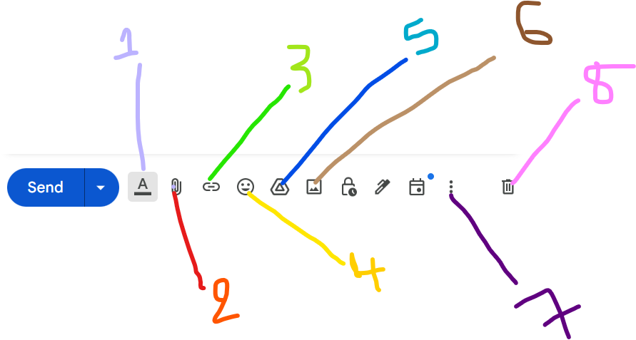
1- A : add or omit the table of chices on.
2- Add/ attach a file or a folder, or document
3- Insert a link
4- Insert Imoji
5- Insert a file using drive
6- Insert a Photo
7- Have more options
8- Discard Draft

Slide 4
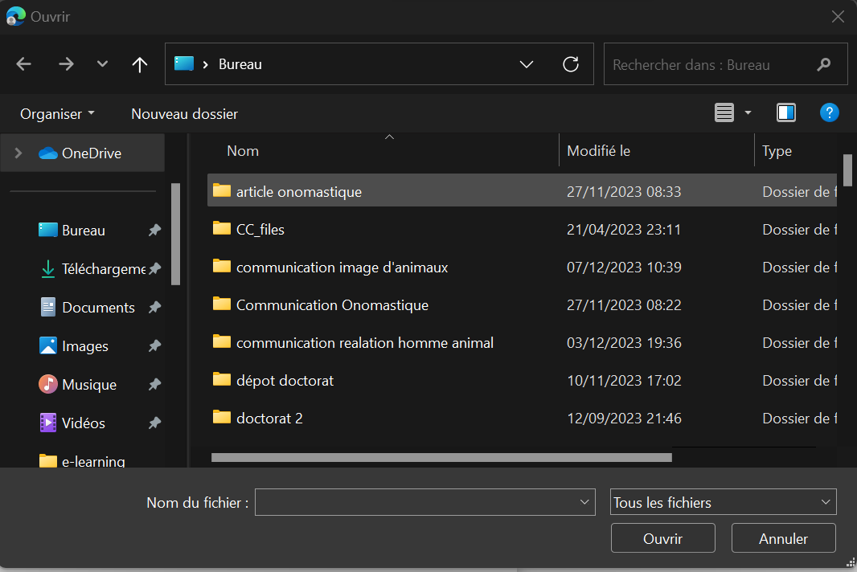
How attach a document to an e-

Slide 5
Chose the document you want to send by clicking on,
Click on Open,
If the document is insert in a folder, you have to select the file.

Slide 6
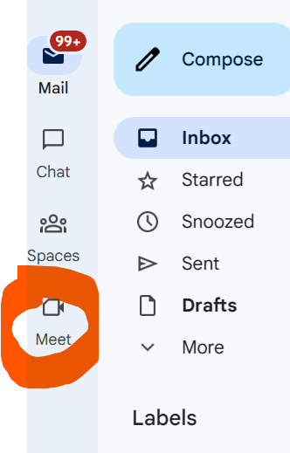
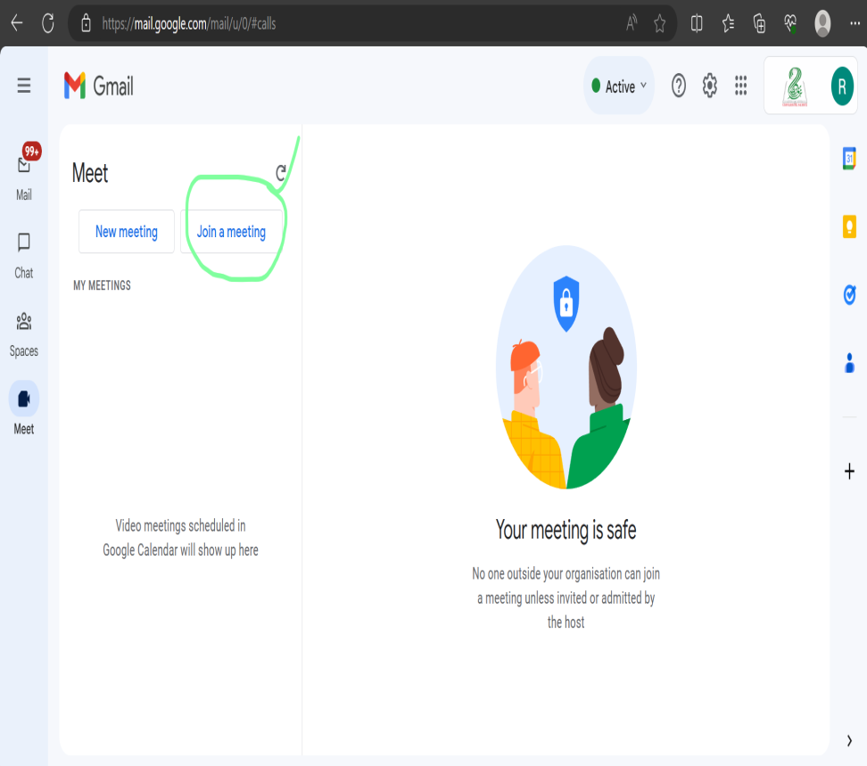
Join a meeting

Slide 7
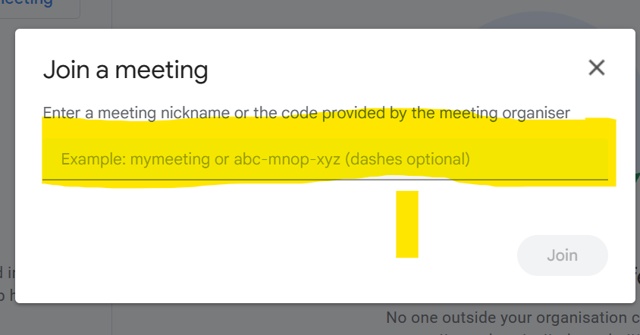
Join a meeting

Slide 8
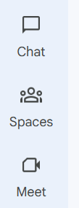
Chat and Sapaces allow the user of Gmail to send a short message one or many contacts.

Slide 9
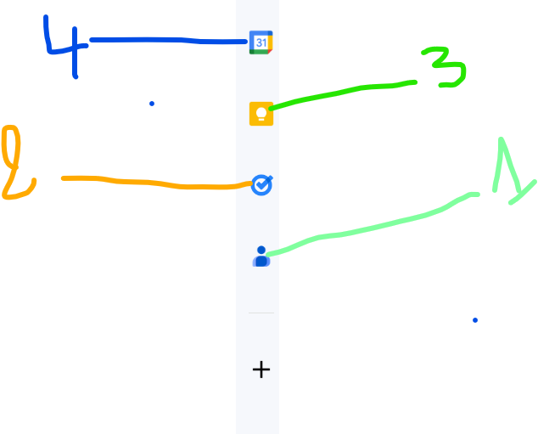
1- contacts: the user can register his contacts. They will be organized and never gone.
2- Tasks the user have to never forgot , can be register in this space.
3- Notes alsow can be register.
4- Calendar give the user date, a calendar and dates of the mane festivities.

Slide 10
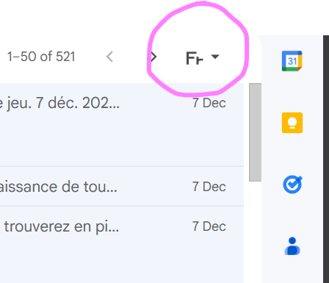
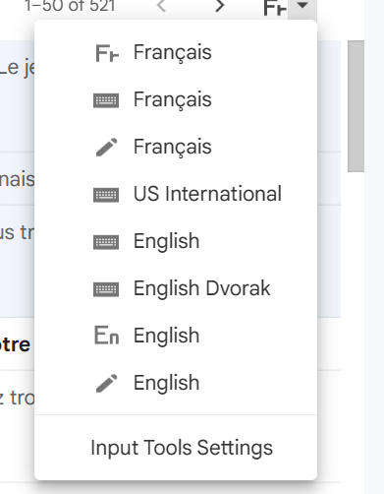
Change the language

