Slide 1
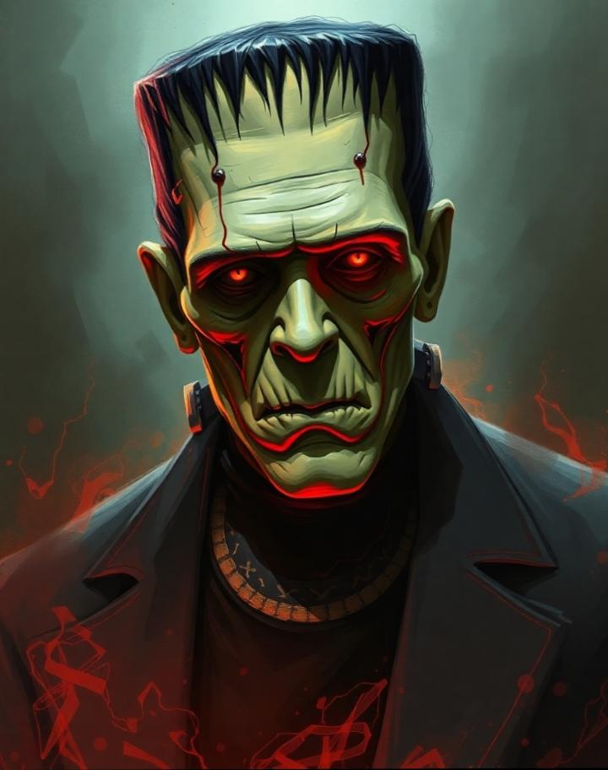
The Gothic Novel: Frankenstein or Modern Prometheus by Mary Shelley
Analysis of Themes, Characteristics, and Legacy

Slide 2
Some monsters are not made; they are created by the cruelty around them. “I am malicious, because I Am miserable.”

Slide 3
Introduction to Gothic Literature
Historical Roots: Gothic literature began in the late 18th century, initially as a counterpoint to the Enlightenment’s focus on reason, by delving into the mysterious, irrational, and supernatural.
Characteristics: It combines romance with elements of horror, often revealing darker aspects of human nature and society.

Slide 4
Key Characteristics:
Dark and Eerie Settings: Common in Gothic novels are remote and eerie locations (castles, mansions) that create a suspenseful and fearful atmosphere.
“The room smelled faintly of lilies, the air thick with a quiet that made her own breathing feel intrusive. The chair by the window sat empty now, the cushion sunken where he used to sit, staring into the endless gray sky.”
Themes: Emphasis on death, decay, and existential dread, often involving inner struggles.
Supernatural Elements: Ghosts, curses, or inexplicable events, adding mystery and fear.
Inner Fears and Moral Dilemmas: Gothic literature frequently examines human psychology, such as suppressed fears, guilt, and moral ambiguity.

Slide 5
Key Elements of Gothic Literature
Setting:Often bleak and isolated, creating a setting that reflects the characters' inner turmoil.
Examples: Ancient castles, monasteries, or desolate natural landscapes. In Frankenstein, the Arctic wilderness and isolated laboratories contribute to this mood.

Slide 6
Themes:
Supernatural vs. Reality: Gothic literature plays with the boundaries between the real and the unreal, creating tension and uncertainty.
Fear and Trauma: Characters often experience intense emotional and psychological strain.
Moral Ambiguity: The good vs. evil dichotomy is complex, with characters who embody both virtues and flaws.

Slide 7
Archetypes and Motifs:
Mad Scientist and Monsters: Often, characters tamper with the natural order (like Victor Frankenstein), leading to chaos.
Haunted Houses and Ghosts: Represent repressed emotions and unresolved pasts.
Persecuted Heroines: Female characters who often face supernatural or human malevolence.

Slide 8
Historical Context of Frankenstein
Most critics consider the Gothic genre a reaction to the "Age of Reason," a movement in 18th-century British and European art and politics that stressed the power of the human mind above all. Empowered by an unchecked faith in humanity, people set out to reshape society: The American and French Revolutions erupted, and the Industrial Revolution forced people into long grueling days in factories. The Gothic novelists aimed to represent the dark side that accompanied this age of apparent human progress. At a time when writers and thinkers had begun to believe in the "infinite perfectability of man," Gothic novelists portrayed human beings as woefully imperfect and at the mercy of far more powerful forces, such as nature and death.

Slide 9
Mary Shelley and Frankenstein
Mary Shelley’s Background
Personal Life: Mary Shelley was the daughter of political philosopher William Godwin and feminist Mary Wollstonecraft, which influenced her intellectual curiosity.
Writing of Frankenstein: Written in 1816, Frankenstein was conceived during a summer gathering with Percy Shelley, Lord Byron, and others, where they challenged each other to write ghost stories.

Slide 10
Inspiration and Creation:
Influences: Shelley drew from Romanticism (focus on nature and emotion) and the scientific advances of her time, especially in biology and chemistry.
Motivation: Her tale was inspired by the myth of Prometheus and the potential consequences of human overreach.

Slide 11
Why Modern Prometheus
Mary Shelley’s Frankenstein is subtitled The Modern Prometheus because it draws parallels between Victor Frankenstein and the Greek Titan Prometheus. Prometheus defied the gods by bringing fire (knowledge and enlightenment) to humanity, an act that symbolizes the pursuit of knowledge and progress. Similarly, Victor Frankenstein defies natural laws by creating life through science. Both figures face severe consequences for their actions, highlighting themes of hubris, the ethical boundaries of scientific exploration, and the responsibilities of creators.

Slide 12
Plot Summary
In Frankenstein, Victor Frankenstein, an ambitious young scientist from Geneva, becomes fascinated with the power of science and the idea of creating life. While studying at the University of Ingolstadt, he immerses himself in the study of natural philosophy and chemistry. Driven by the desire to unlock the mysteries of existence, he succeeds in creating life by animating a creature made from various human body parts.
When the creature awakens, Victor is horrified by its monstrous appearance and flees, abandoning it. Alone and rejected, the creature learns about the world by observing humans, and it grows increasingly intelligent and self-aware. Despite its gentle nature, the creature faces relentless rejection and scorn due to its grotesque appearance. This suffering transforms its innocence into rage and bitterness, and it resolves to confront Victor, whom it blames for its miserable existence.

Slide 13
The creature eventually tracks Victor down and begs him to create a female companion, hoping companionship will ease its loneliness. Initially agreeing, Victor later destroys the female creature out of fear that the pair could become a threat to humanity. Enraged by this betrayal, the creature vows revenge, leading to a series of tragic events. It murders Victor’s younger brother William, his friend Henry Clerval, and ultimately, his fiancée Elizabeth on their wedding night.
Consumed by grief and guilt, Victor dedicates himself to hunting down the creature, pursuing it across Europe and eventually into the Arctic. There, the weakened Victor meets Captain Robert Walton, who is leading an expedition and records Victor’s tragic story. Shortly after, Victor dies from exhaustion, and the creature appears to mourn over its creator’s body. In a final act of despair, the creature vows to end its own life and disappears into the Arctic wilderness.
Shelley’s novel not only explores the devastating consequences of unchecked ambition and the moral obligations of creation but also examines themes of alienation, revenge, and the deep need for companionship and acceptance.

Slide 14
Central Conflict
Victor Frankenstein, in his quest for knowledge, creates a sentient being, leading to his downfall and the ruin of those he loves.
The Creature, ostracized and vengeful, embodies themes of alienation and the consequences of human hubris.

Slide 15
The creature’s sentience
“It is with considerable difficulty that I remember the original era of my being; all the events of that period appear confused and indistinct. A strange multiplicity of sensations seized me, and I saw, felt, heard, and smelt at the same time.”
“But where were my friends and relations? No father had watched my infant days, no mother had blessed me with smiles and caresses. I had never yet seen a being resembling me, or who claimed any intercourse with me. What was I?”
“Cursed, cursed creator! Why did I live? Why, in that instant, did I not extinguish the spark of existence which you had so wantonly bestowed?”

Slide 16
Frame Narrative in Frankenstein
Structure and Function
1-Outer Frame: Captain Robert Walton’s Letters
Context: The novel begins with letters from Captain Walton to his sister, Margaret Saville, in England.
Narrative: Walton recounts his expedition to the Arctic and the discovery of Victor Frankenstein, near death, and listens to Victor’s story.
Purpose: Walton's letters introduce the story and frame Victor’s narrative, offering a perspective on ambition and the consequences of seeking knowledge. Walton’s ambitions mirror Victor’s, providing an external judgment of the main events.

Slide 17
2-Middle Frame: Victor Frankenstein’s Story
Context: Within the outer frame, Victor tells his tragic story to Walton after being rescued.
Narrative: Victor recounts his youth, scientific ambitions, and the creation of the Creature, his neglect of it, and the ensuing consequences.
Purpose: Victor’s perspective forms the heart of the novel, emphasizing the themes of ambition, guilt, and responsibility. His narrative is more personal, filled with emotional reflection but also biased by his guilt and pride.

Slide 18
3-Inner Frame: The Creature’s Story
Context: The Creature narrates his experiences to Victor, explaining his creation, loneliness, rejection, and desire for revenge.
Narrative: The Creature shares his journey from innocence to bitterness, showing the human side of the monster.
Purpose: This layer contrasts with Victor’s account, adding depth to the Creature’s character and allowing readers to sympathize with his plight, challenging Victor’s role as a victim.

Slide 19
Why Frame Narrative Works
Multiple Perspectives: Provides a richer, more complex story by offering different viewpoints (Walton, Victor, the Creature).
Themes of Isolation and Ambition: Highlights the consequences of unchecked ambition and the theme of alienation from both human society and nature.
Reliability and Bias: The layering of subjective accounts forces the reader to evaluate each narrator's perspective critically.

Slide 20
Gothic Themes in Frankenstein
Isolation and Alienation:
Both Victor and the Creature experience profound isolation that drives them to despair and ultimately violence.
Forbidden Knowledge and Its Consequences:
The dangers of "playing God" and transgressing natural boundaries reflect Gothic anxieties around science and ethics.
Nature as Reflection:
Nature mirrors characters' internal struggles, highlighting Romantic and Gothic ideals of the sublime and human insignificance.

Slide 21
Philosophical and Ethical Questions in Frankenstein
Creation and Responsibility:
Explores ethical dilemmas of creation: Should creators be responsible for their creations? What are the moral limits of scientific discovery?
Human Identity and Alienation:
The Creature’s struggle to find identity and belonging mirrors themes of alienation and rejection faced by marginalized groups.
The Search for Meaning:
The novel reflects the existential question of purpose and the despair of a creator whose work leads to unintended suffering.

Slide 22
Frankenstein in the Context of Romanticism
Romantic Ideals and Rebellion:Emphasizes emotions, the supernatural, and the struggle against societal norms; key Romantic themes.
The Sublime in Nature:Nature in Frankenstein serves as a source of wonder and terror, reflecting Romanticism’s fascination with the sublime and human vulnerability.
Contrast with Enlightenment Values:Romanticism’s emphasis on intuition and emotion challenges Enlightenment ideals of reason and progress, illustrated in Victor’s downfall.

Slide 23
Emotion and the Individual
Victor Frankenstein: The novel’s protagonist embodies Romantic qualities of individualism and intense emotion. His obsessive pursuit of knowledge and his ambition to transcend human limitations reflect a uniquely Romantic focus on the individual’s inner world and desires. He fits the mold of the Romantic, or Byronic, hero—a character marked by intense ambition, moral ambiguity, isolation, and self-destructive tendencies. His relentless quest for knowledge isolates him from family and friends, ultimately leading to his downfall.
The Creature: The Creature’s intense feelings of loneliness, despair, and rage also align with Romantic themes. Shelley's portrayal of the Creature as an initially gentle and sensitive being, who becomes vengeful due to rejection, underscores Romanticism’s focus on the impact of society and experience on individual emotion.

Slide 24
Frankenstein’s Legacy in Gothic and Science Fiction
Impact on Gothic Literature:
Frankenstein expanded Gothic themes by introducing scientific horror, inspiring future works in both Gothic and sci-fi genres.
Influence on Science Fiction:
Themes of artificial life, ethics of creation, and consequences of human ambition laid the groundwork for modern sci-fi narratives.
Cultural Adaptations:
Countless adaptations in film, literature, and theater underscore the story’s continued relevance in exploring complex ethical issues.

