Slide 1
Prehistory and
Pictographs

Slide 2
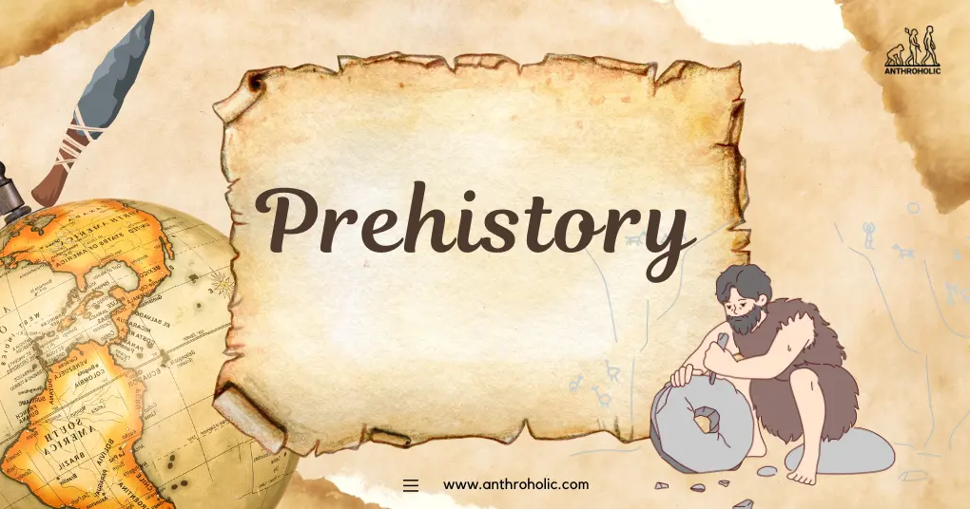
Prehistory
History
before written records
written records

Slide 3
Prehistory
is the study of the era which preceds written history
➔ Stone Age ➔ Bronze Age ➔ Iron Age

Slide 4
Filling the Gaps
In History: making deductions of facts
In Prehistory: tracing developments backwards in time

Slide 5
Characteristics
1) Flexible time limits
Why?
Determined by when writing was invented
depends on the place

Slide 6
Characteristics
2) Stretched over immense periods of time
3) Spread out like a jigsaw puzzle

Slide 7
Concerns
1) Finding, identifying, and explaining the solid and visible traces left by the prehistoric man

Slide 8
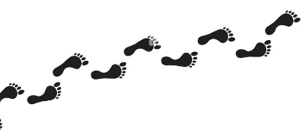
Traces Left by the Prehistoric Man
➔ Structures
➔ Living sites
➔ Burial places

Slide 9
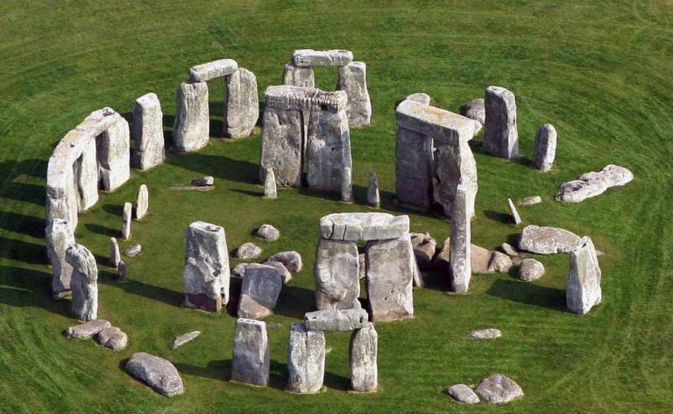

Slide 10
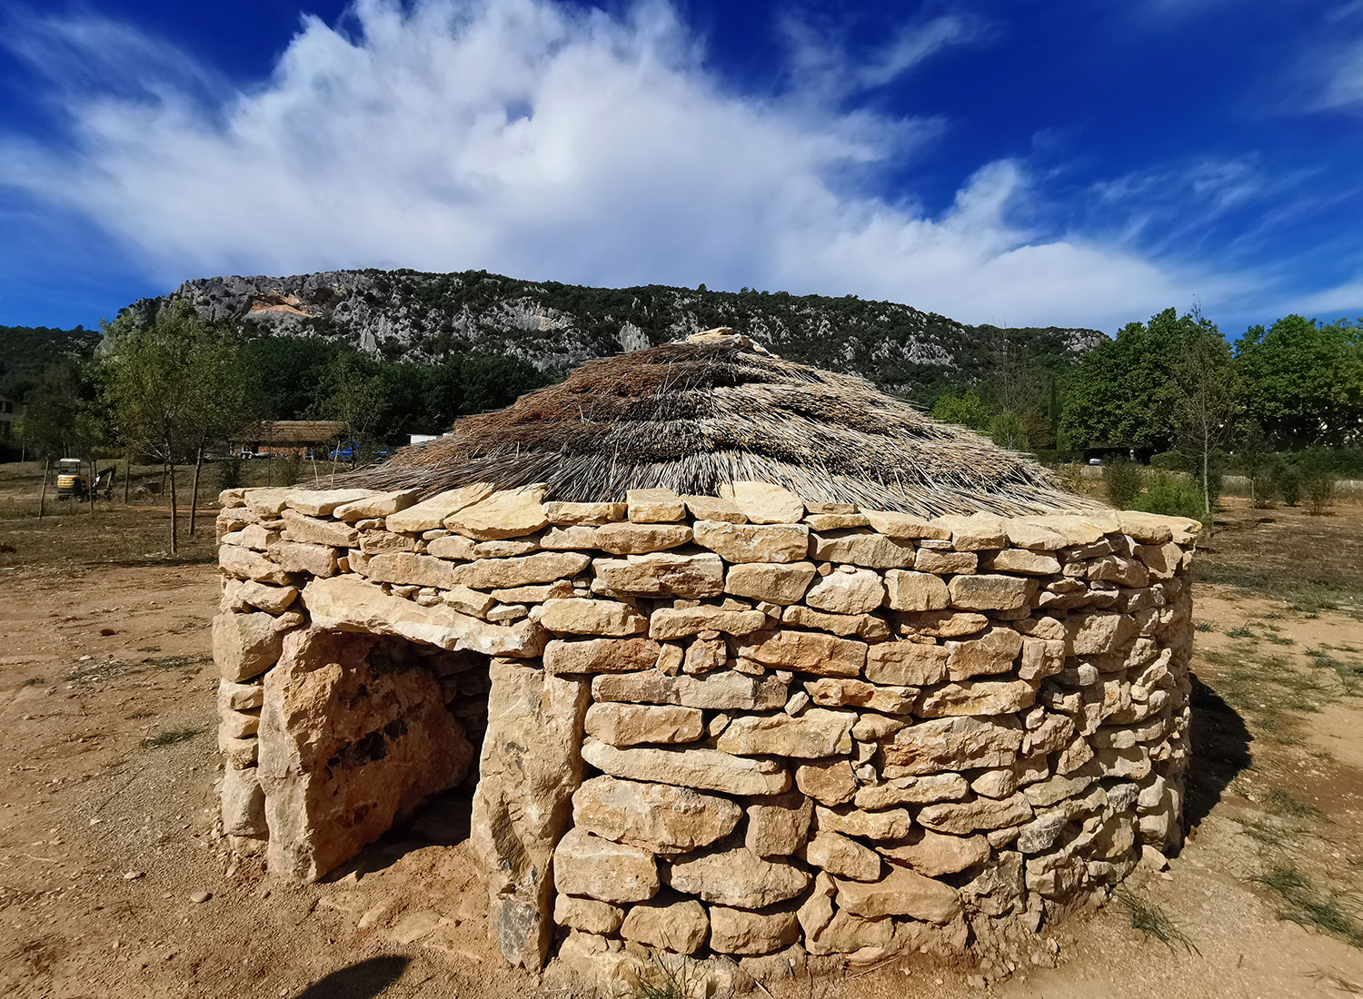

Slide 11
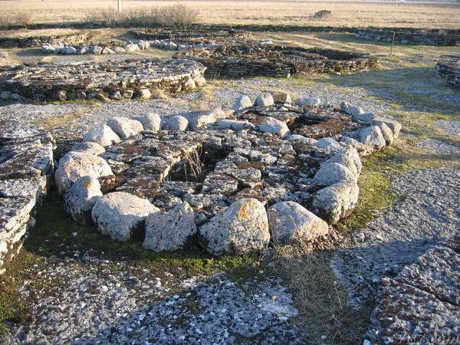
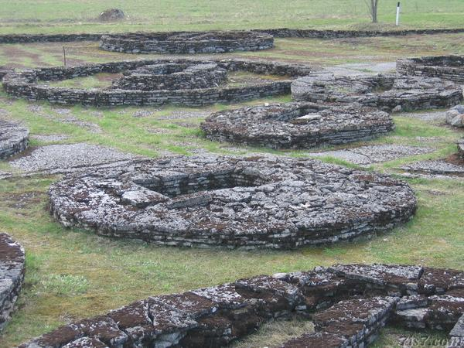

Slide 12
Traces left by the prehistoric man
➔ Artifacts
(weapons, tools, ornaments, receptacles…etc)
Implements and
manufactured items

Slide 13
Concerns
2) Studying the natural background to prehistoric human existence
•Climate •Animals •Distribution of land

Slide 14
Pictographs
images, signs, or symbols drawn on rock walls in order to express some idea or information

Slide 15
Related Terminology
• Petrograms: drawn or painted
Rock Art
• Petroglyphs: cut or carved

Slide 16
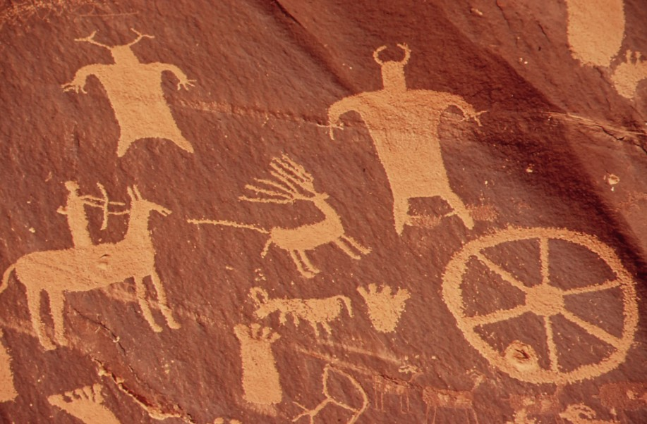
Indian Creek State Park in Utah, USA.
-Plants
and minerals -Sticks, fingers, or hands

Slide 17
Types of Pictographs
1) Abstract Symbols
2) Hand Stencils

Slide 18
Types of Pictographs
3) Rock Engravings
4) Cave Paintings

Slide 19
Types of Pictographs
Abstract Symbols, Hand Stencils, Rock Engravings, Cave Paintings
Basic
Complex

Slide 20
Basic
Complex
Made by one, and only one, unit
Made by assembling or fusing basic units
cow
ax
Notes:
The Dongba, Tomba or Tompa or Mo-so symbols are a system of pictographic glyphs used by the ²dto¹mba (Bon priests) of the Naxi people in southern China

Slide 21
The Importance
They provide valuable insight into the social and spiritual lives of prehistoric peoples by revealing their relationships with the natural world and each other.

Slide 22
Text Discussion

